Slide 1
Health Qigong
A Gem of Chinese Traditional Culture
Wang Zhen
Li Wei
Liu Xiaolei

Slide 2
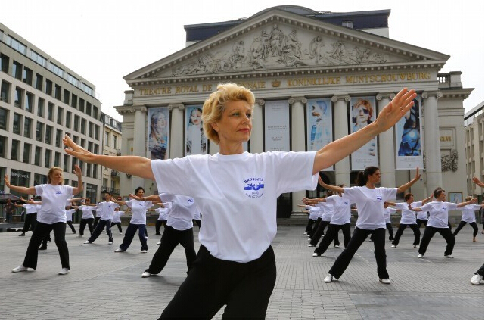
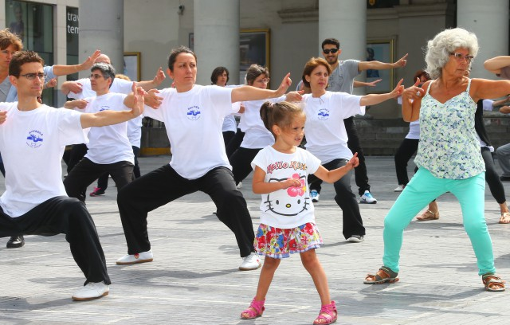
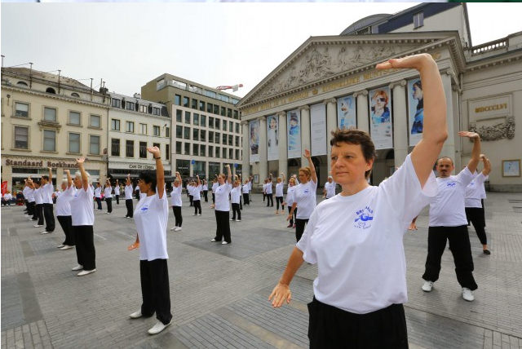

Slide 3
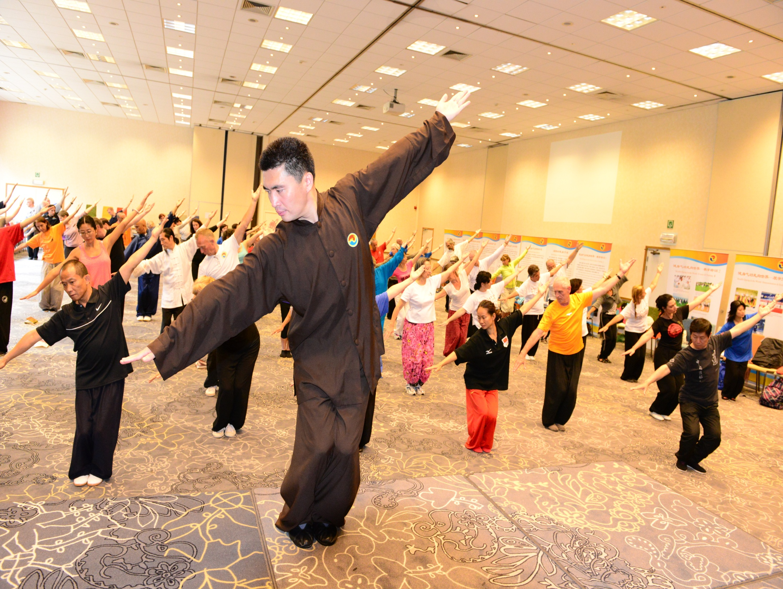

Slide 4
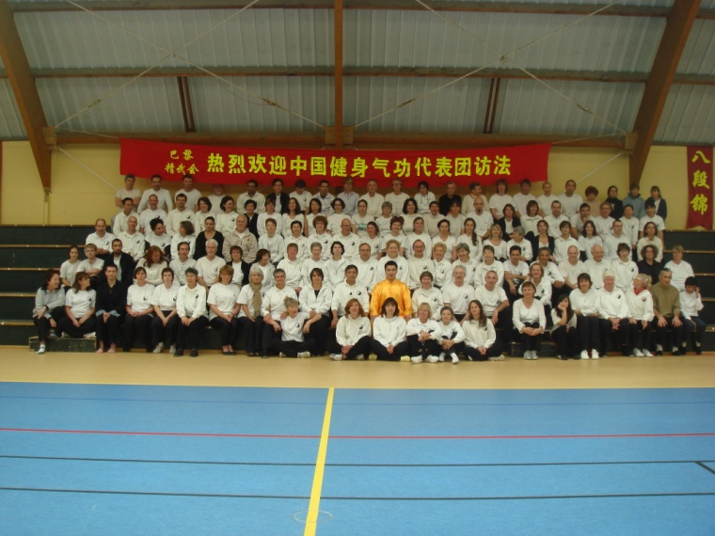

Slide 7
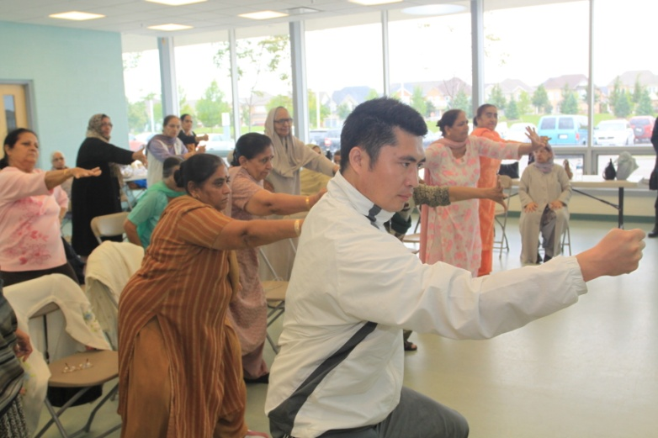
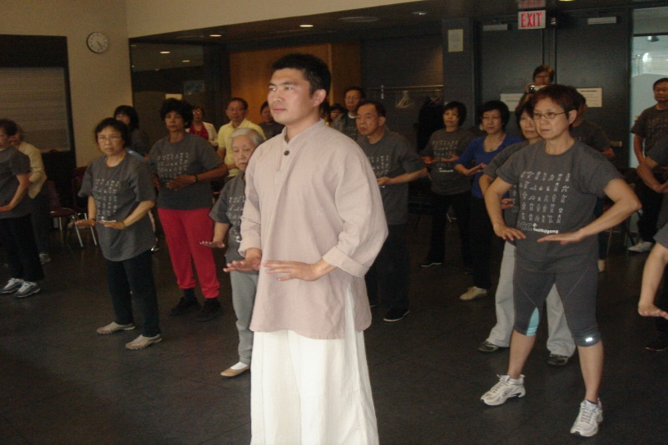
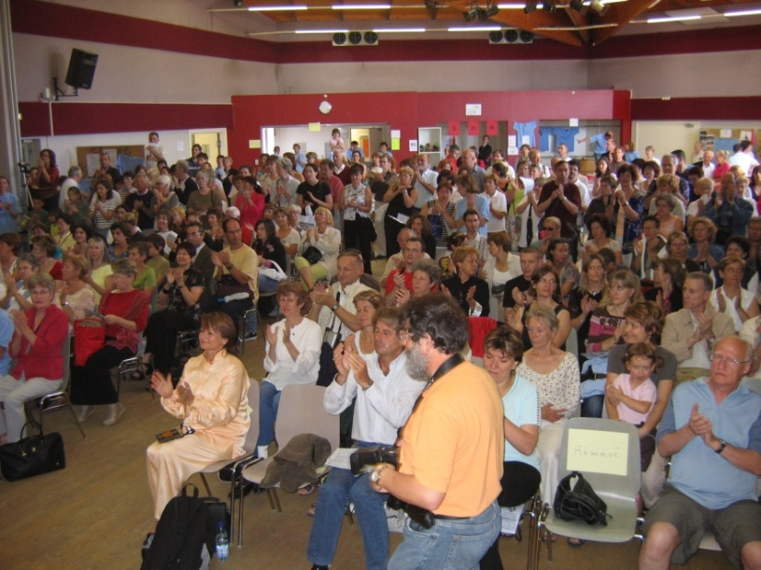
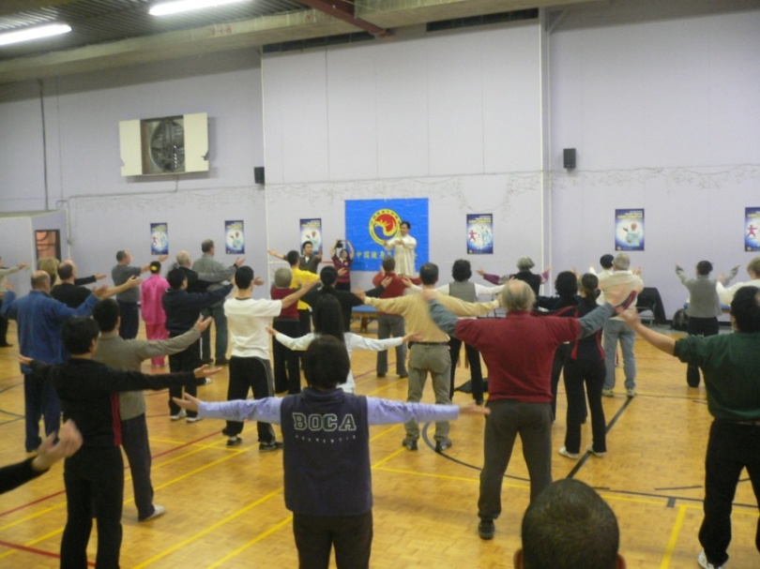

Slide 10
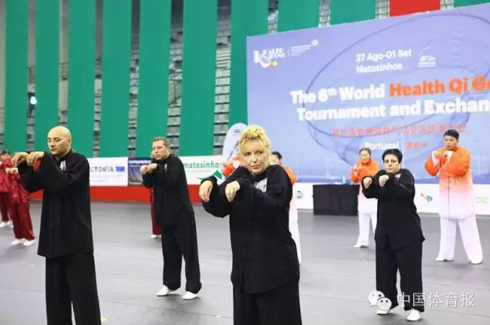

Slide 11
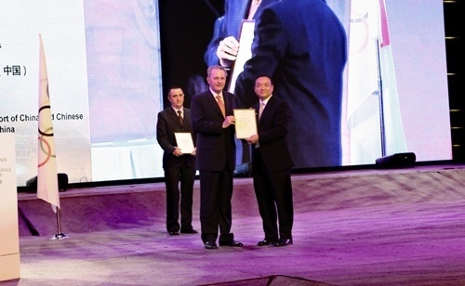
The IOC Sport for All Grant QACSC

Slide 12
气功是中国优秀传统文化的重要组成部分，其特有的养生理论蕴含着儒家、道家、佛家等中国哲学思想的文化理念，强调人与自然、人与社会合一，进而达到身心和谐的完美境界。
As a significant element in traditional Chinese culture, Qigong assembles Confucian cultivation of body and mind; Taoist pursuit to transcend worldliness; Chinese keep healthy theory. It also combines the ancient Chinese philosophy of the harmony in human society and between human and nature.

Slide 13
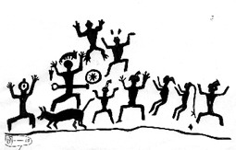
气功是中华民族的文化瑰宝，它历史悠久、源远流长。目前能够证实的至少5000年前我们的先人就有意识的进行了呼吸吐纳的气功活动。气功所包含的内容极为丰富。我国古代道家的吐纳、行气、内丹，佛家的禅定、观想，医家的导引、按跷，儒家的修身、养气，武术的内功修炼等等都有气功习练的内容。

Slide 14
Taoists and Buddhists do it to transcend worldliness;

Slide 15
Confucians practice Qigong to cultivate mind and body.
Confucius

Slide 16
Chinese medical physicians use it to cure illness and keep health;

Slide 17
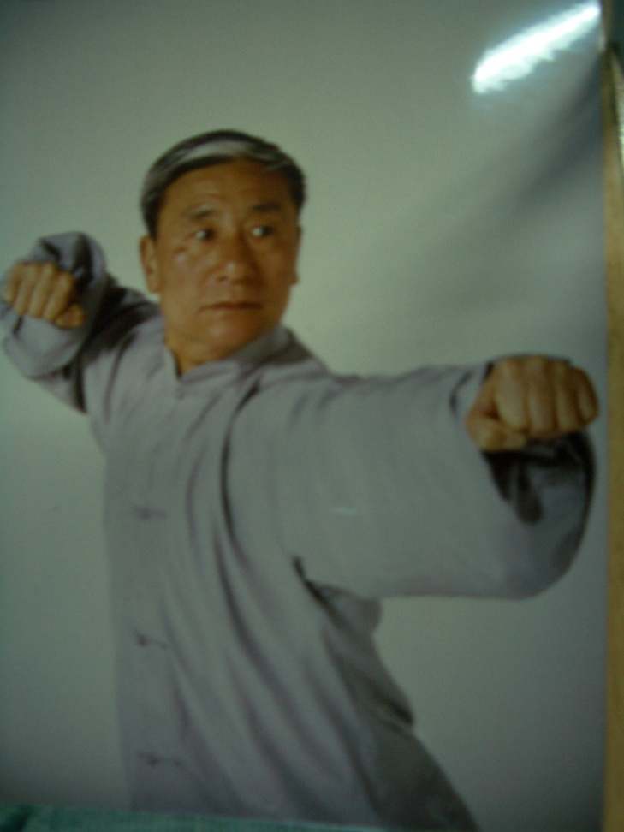
Wushu learners practice it to defend themselves and fight against attacks.
Cai Longyun

Slide 18
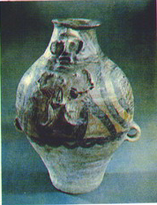
Qigong has a long history with rich connotations
On the archeological objects of the pottery jars in color which was made during the Majiayao culture period and excavated in Qinghai Province, China, colorful drawings of people are seen practicing Qigong, indicating that 5000 years B.C., the Chinese ancients did understand to build up health by way of practicing Qigong.

Slide 19
History
Origin
Ancient
Modern
远观近择
取象比类
To observe and imitate selectively from the nature
（伸懒腰、闭目、站桩、嘘、呵）
儒Ru
释Shi
道Tao
医Yi
武Wu
内养功
Neiyang Gong
放松功
Fangsong Gong
健身气功
Health Qigong

Slide 20
What is Health Qigong?
Health Qigong is a traditional Chinese health exercise with improvement of mental and physical health as it aim, it’s a combined system including body movement, breathing exercise and psychological adjustment as its main content.

Slide 21
It known as an component of traditional Chinese culture, originated in ancient China and its functions vary in different traditional Chinese cultural schools.

Slide 22
健身气功
健身气功是以增进身心健康为目的，以自身形体活动、呼吸吐纳、心理调节相结合为主要运动形式的民族传统体育项目，是中华悠久文化的组成部分。”
2002年，健身气功成为中国国家体育总局正式认可的第62个体育运动项目。

Slide 23
健身气功是一门关于和谐的学问，在理论上以人体生命整体观为指导，在实践上以三调合一为基准，既体现了中华传统文化智慧，也吻合现代养生学理念，是当今人们健身养生的时尚运动。

Slide 24
Health Qigong
健 身 气 功
1568
易筋经
五禽戏
六字决
八段锦
Yi Jing Jing
Wu Qin Xi
Liu Zi Jue
Ba Duan Jin

Slide 25
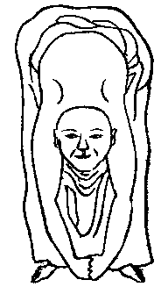
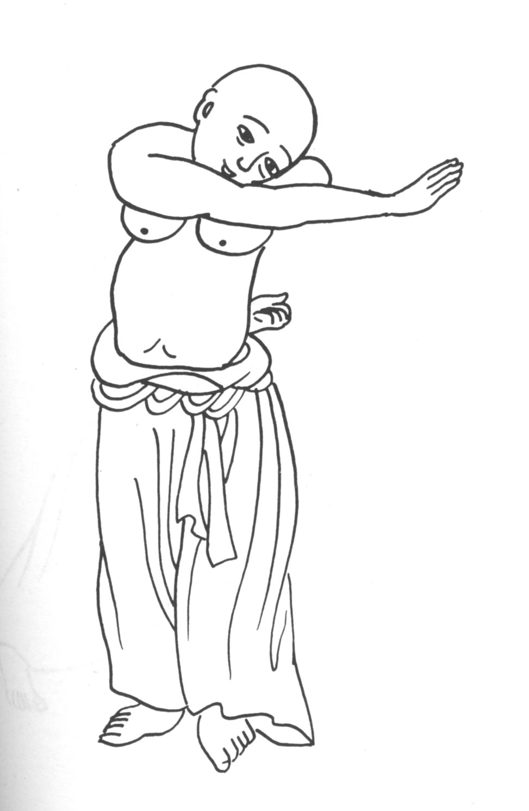
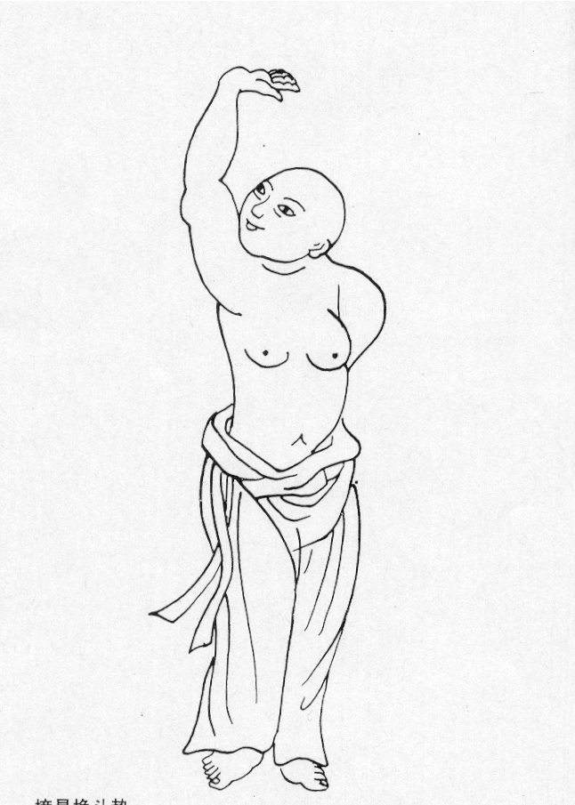
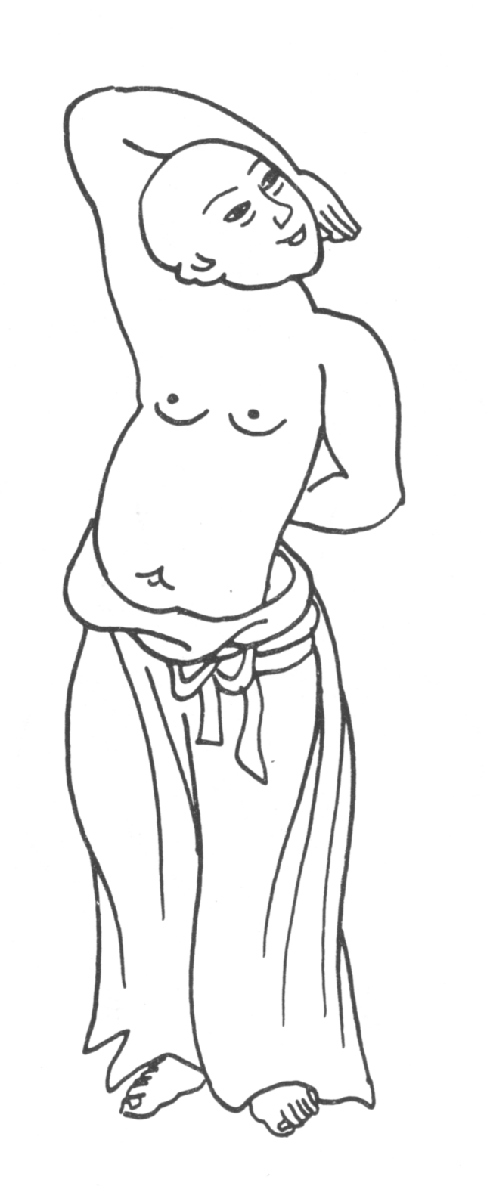
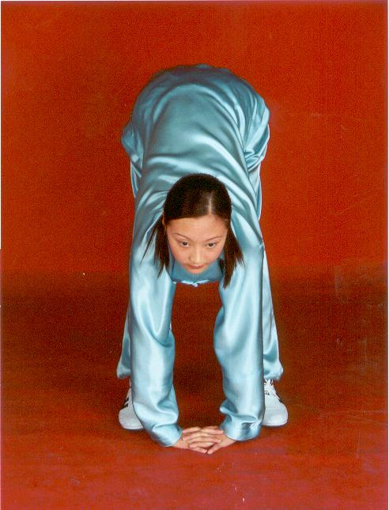
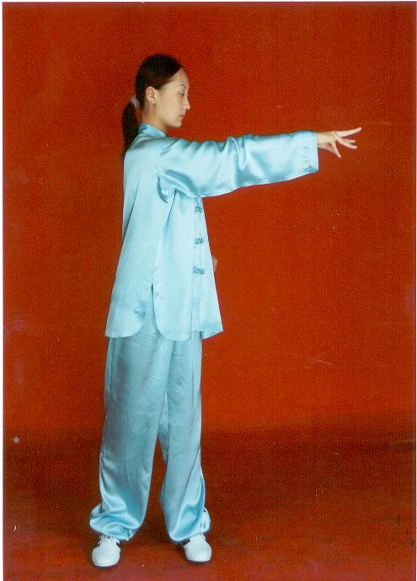
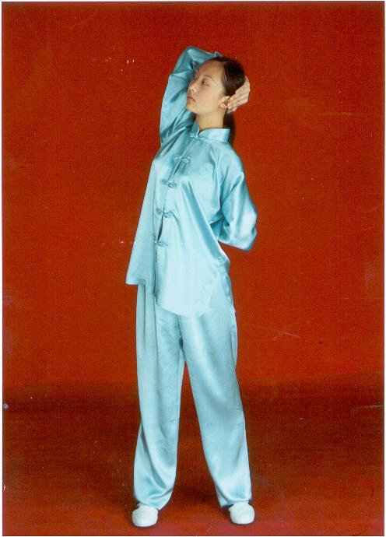
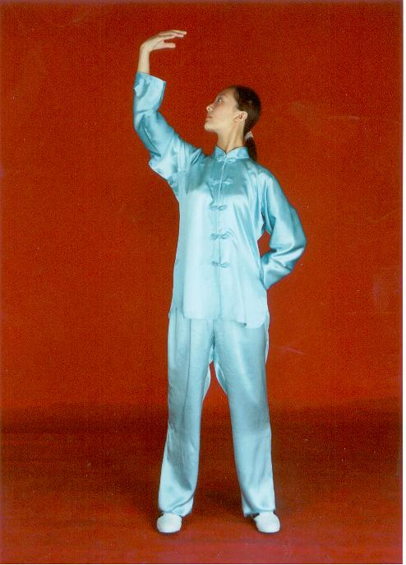
易 筋 经
Yi Jin Jing
掉 尾 势
九鬼拔马刀势
青龙探爪势
摘星换斗势

Slide 26
易筋经 Yi Jin Jing
Yi Jin Jing is a method of health-building exercise that came down from ancient China, and its purpose is to strengthen the muscles and tendons. By the textual research, Yi Jin Jing germinated from regimens in the Qin and Han Dynasties. Legend goes that the monk Bodhidharma, the founder of Zen in China, advanced Yi Jin Jing. And then the monks in Shaolin Temple developed it and used it for health promotion. In the Tang and Song Dynasties, Yi Jin Jing developed greatly. It began to spread out of the temple from the Ming Dynasty. Yi Jin Jing has been greatly influencing the traditional Chinese national sports.

Slide 27
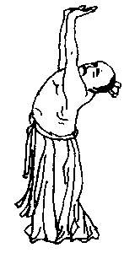
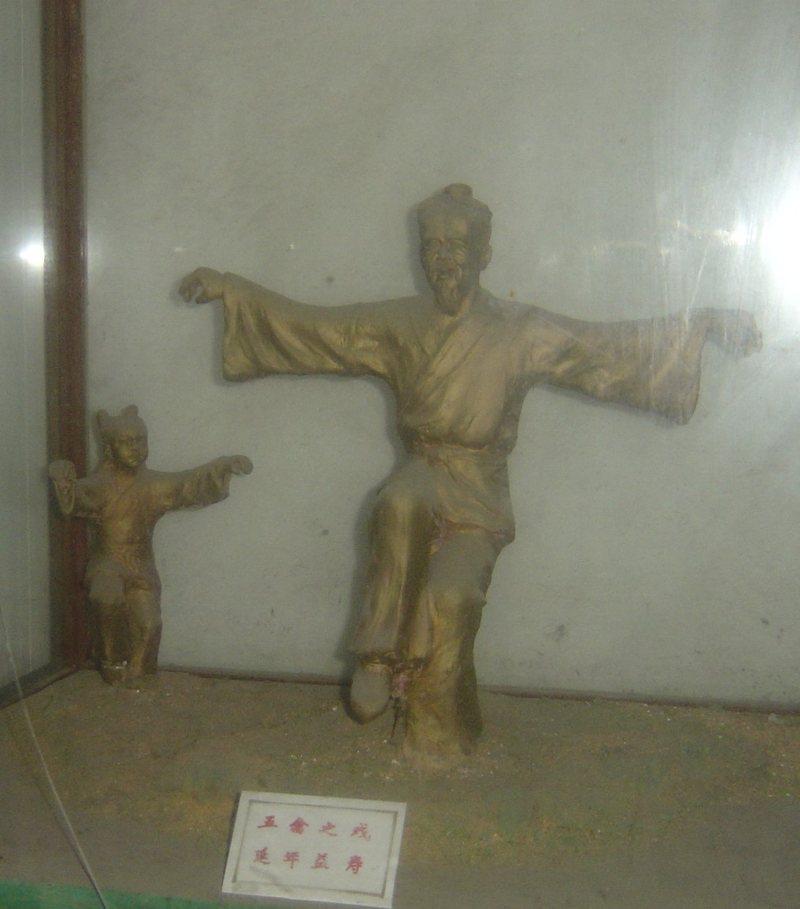
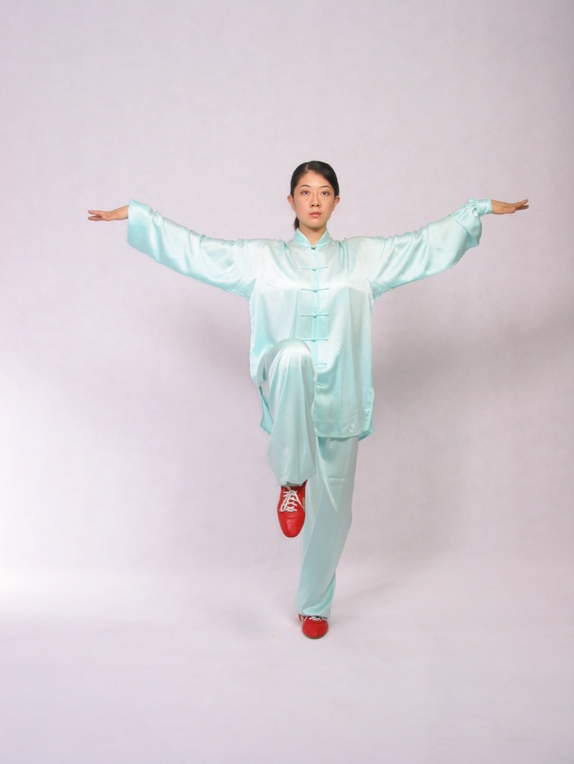
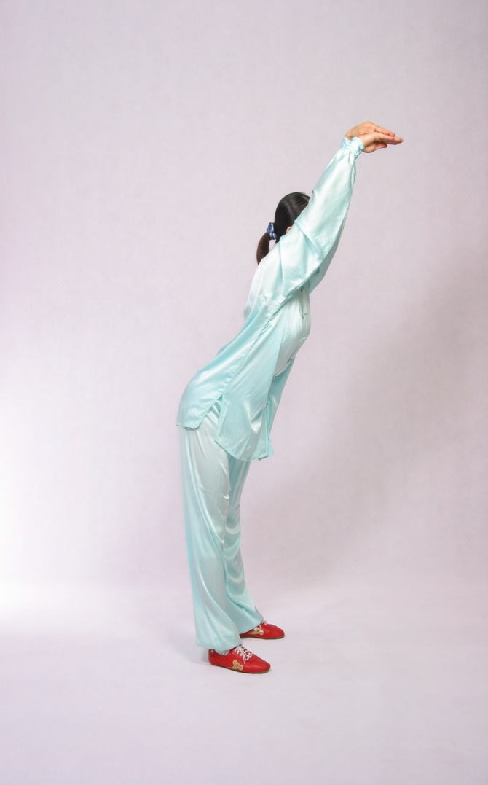
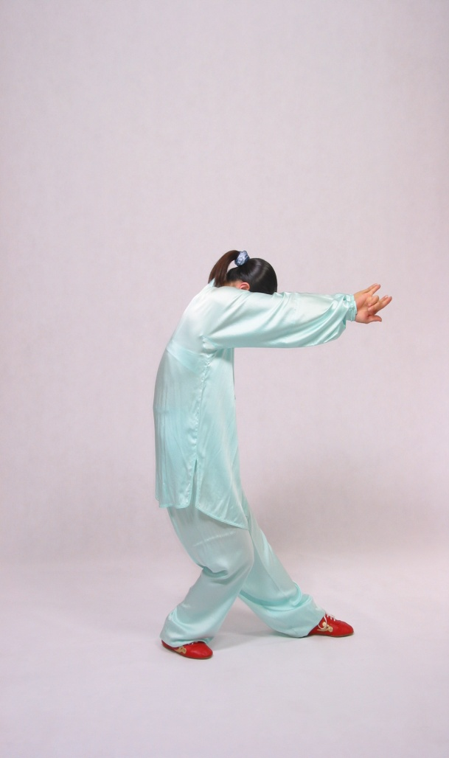
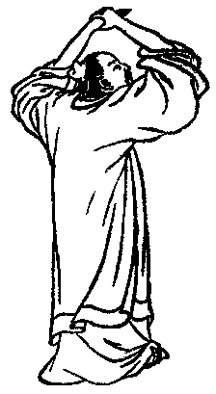
Wu Qin Xi
华祖庵五禽戏雕像
鸟戏：鸟飞
《赤凤髓》：鸟形
四时坐功却病图诀
导引图：引背痛
虎戏：虎 举
鸟戏：鸟伸
鹿戏：鹿奔

Slide 28
五禽戏 Wu Qin Xi
Wu Qin Xi (frolics of five animals) was developed by Hua Tuo, the most famous doctor in the Eastern Han Dynasty. It imitates the tiger, deer, bear, monkey and bird, and combines Tu Na (the art of expiration and inspiration) and Dao Yin (the movements of the limbs in Qigong) with the theories of Viscera, Channels and Collaterals, Qi and Blood in Traditional Chinese Medicine.

Slide 29
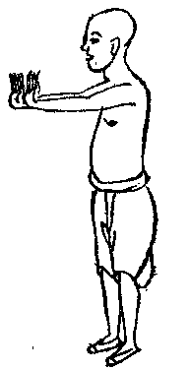
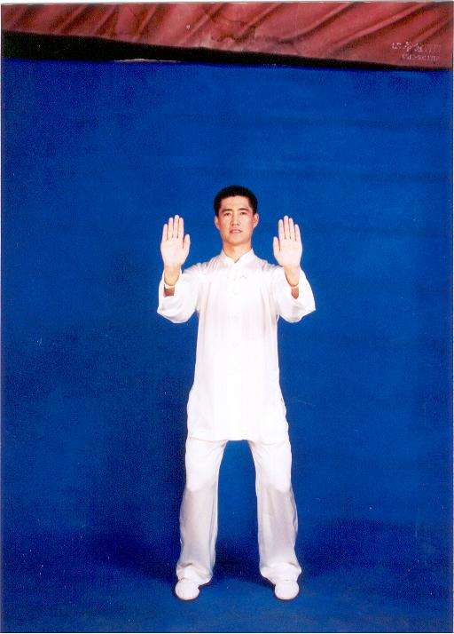
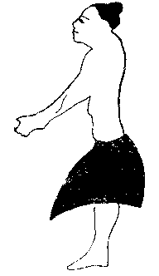
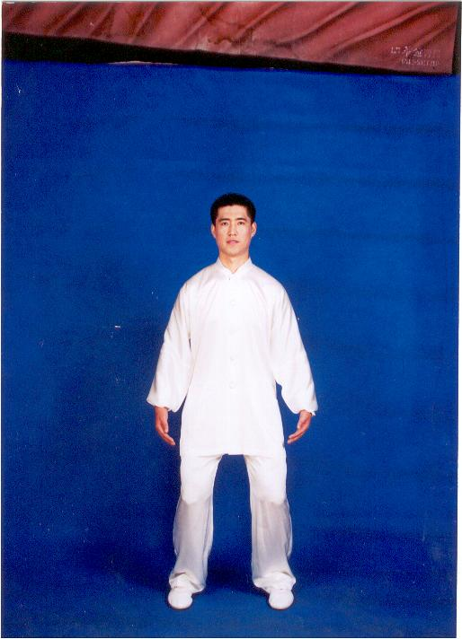
Liu Zi Jue
服气祛病图说：平和架
六字诀：呬字诀
六字诀：吹字诀
导引图：龙息

Slide 30
六字诀 Liu Zi Jue
Liu Zi Jue (the art of expiration in producing six different sounds) is a traditional exercise of health promotion. It is practiced through the art of expiration. Liu Zi Jue is of a long history and has been spread wide. There existed the records of Liu Zi Jue in the Southern and Northern Dynasties. During the process of its spread, the masters of medicine and regimen in various generations replenished and improved it in different aspects.

Slide 31
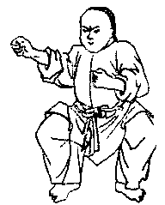
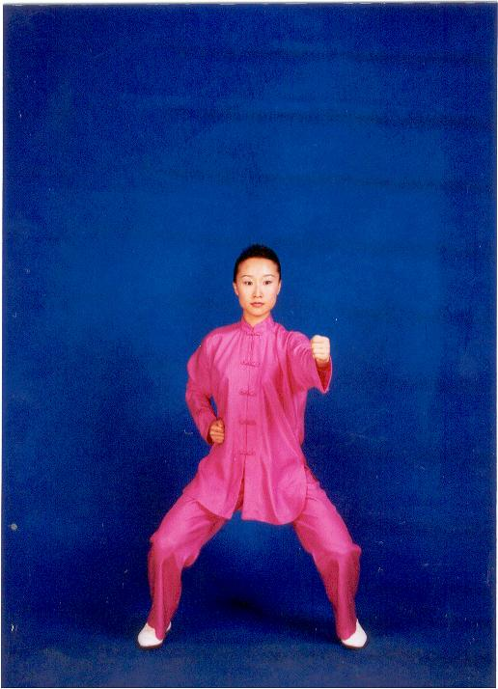
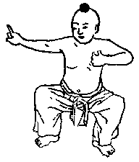
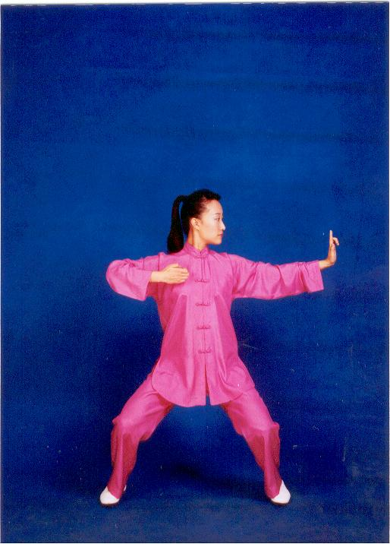
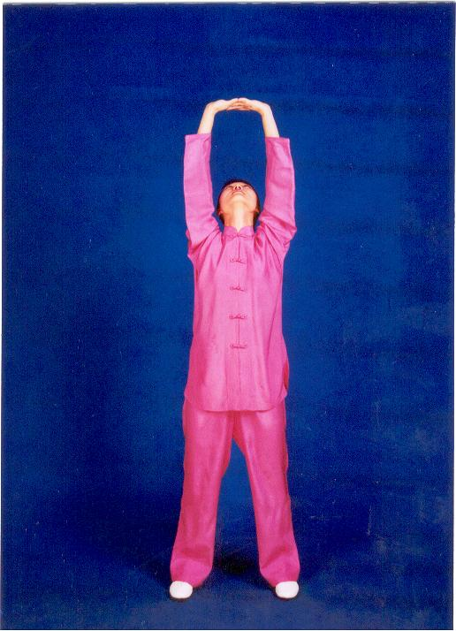
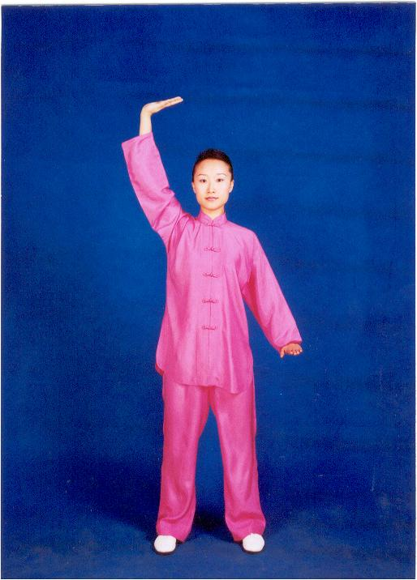
Ba Duan Jin
调理脾胃须单举
双手托天理三焦
攥拳怒目增气力
左右弯弓似射雕

Slide 32
八段锦 Ba Duan Jin
Ba Duan Jin (eight excellent movements), emerged before the Song Dynasty, and gradually developed to a perfect degree during the periods of the Ming and Qing Dynasties. Being a traditional health-promoting exercise jointly developed by the masters of the regimen and practitioners in the past Dynasties, Ba Duan Jin, the treasure of the Chinese regimen culture is popular with the broad mass, for its movements are simple and easy to learn, and bring about good results in health-building.

Slide 33
D-M-S-T-W
导引养生功十二法
Dao Yin Yang Sheng Gong Shi Er Fa
D
马王堆导引术
Ma Wang Dui Dao Yin Shu
大舞
Da Wu
W
M
健身气功
Health Qigong
太极养生杖
Tai Ji Yang Sheng Zhang
T
S
十二段锦
Shi Er Duan Jin

Slide 34
The essence of Qigong
Qigong is a psychosomatic practicing skill that adjusts body, breath and mind into one.
The first adjustment is to adjust posture and movement.（调身）
The second is to adjust breath type.（调息）
The third is to adjust mental activities.（调心）
It forms the special psychosomatic state of Qigong practice when integrating the “three adjustments into one”.（三调合一）

Slide 35
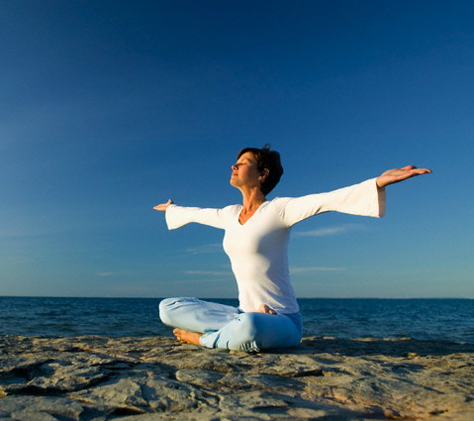
减少呼吸频率 Decreases respiratory rate
Increase maximum oxygen intake (VO2 max)

Slide 36
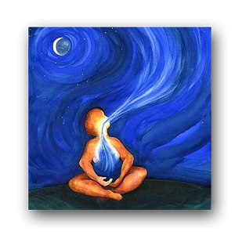
每分钟呼吸的次数 THe number of breaths (inhalation-exhalation cycles) taken within a set amount of time (60 seconds).
呼吸频率
Respiratory Rate (RR)

Slide 37
呼吸频率的正常范围 Normal Range
健身成年人的呼吸频率12-20次/分钟
The typical respiratory rate for a healthy adult at rest is 12–20 breaths per minute.
Ganong's Review of Medical Physiology (24 ed.). p. 619. ISBN 0071780033.

Slide 38
呼吸系统 Respiratory system

Slide 39
无效腔 Dead space
无效腔大约占据人体安静状态下的每次吸入或呼气量的三分之一。
The normal value for dead space volume is approximately the lean mass of the body, and averages about a third of the resting tidal volume (450-500 mL). In Fowler's original study, the anatomic dead space was 156 ± 28 mL (n=45 males) or 26% of their tidal volume.

Slide 40
每分钟呼吸量 Respiratory volume per minute
在安静状态下成年人每分钟呼吸量在5-8升。
The normal volume while resting is about 5–8 liters per minute in humans.
Zuurbier, M., Hoek, G., van den Hazel, P., Brunekreef, B. (2009). "Minute ventilation of cyclists, car and bus passengers: an experimental study.". Environmental Health8 (48). doi:10.1186/1476-069x-8-48.

Slide 41
1 minute: 8,000 ml, Dead space:150ml
20 times：8,000 ml
1 time ： 400 ml
400-150=250ml
250*20=5,000 ml/m
10 times: 8,000 ml
1 time : 800 ml
800-150=650 ml
650*10=6,500 ml/m

Slide 42
Defferent RV Contrast table (ml)
times | 1 time | 1 minute | 1 hour | 1 day
20 | 250 | 5,000 | 300,000 | 720,000
10 | 650 | 6,500 | 390,000 | 936,000
5 | 1,450 | 7,250 | 435,000 | 1,044,000
1 | 7,850 | 7,850 | 471,000 | 1,130,400
RV: Respiratory Volume

Slide 43
Suitable age group of Qigong practice
Everyone can benefit from Qigong practice, regardless of age. As it doesn’t require much physical strength consumption, Qigong is an ideal exercise particularly for middle-aged or senior people. In China, Qigong is one of the major morning exercises.

Slide 45
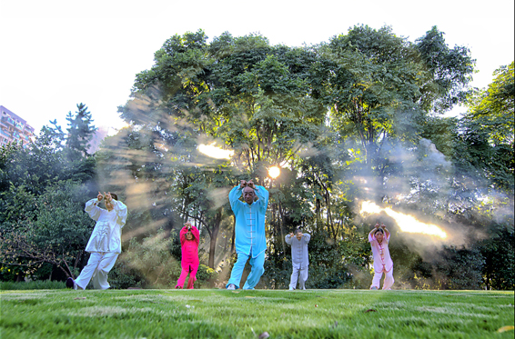
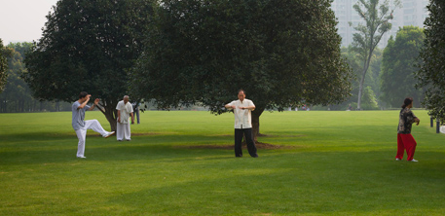

Slide 46
Healthy Effect of Qigong
Qigong benefits physical and mental health, because it can achieve harmony of body, breath and mind and maintain balanced coordination of human organic system through self-adjustment of the three. Its healthy effects have been recognized by modern medicinal science and now it is used as a supplementary and alternative therapy in western medicine.

Slide 47
Physical and Mind Health
增强身体素质
提高生活品質
身心健康
增进心理健康
提高生理功能
延缓智力衰退
改善生化指标
中国传统文化的瑰宝

Slide 48
Enhancing Physical Qualities
科学测试显示，坚持习练健身气功，能够提高身体的反应速度，增强肌肉力量，提高柔韧性和平衡协调能力；练功人群的肺活量、心率、血压也都得到了良性改善。
The scientific tests show that Health Qigong can improve reaction speed , muscle strength, flexibility, balance and coordination ability, vital capacity, heart rate, blood pressure and bone mineral density。

Slide 49
Promoting Mental Health
习练健身气功能够增进心理健康，有效调节因为衰老、疾病及生活压力引起的负面情绪，舒缓心情，消除焦虑和抑郁等症状。
Health Qigong can help adjust practitoners’ spirit, emotion and mental balance, relieve anxiety and blues, focus attention and keep mental state.

Slide 50
Delaying Intelligence Decline
坚持健身气功锻炼能够改善习练者的思维反应速度、肢体灵活性、短时记忆和注意品质，起到延缓中老年人智能生理年龄及其衰老的作用
Health Qigong can better practitioner’ thought reaction speed, body agility, short-term memory and attention quality so that it can delay the aging of elderly people in intelligence and biological age.

Slide 51
Improving Life Quality
坚持习练健身气功能够改善人体的精力、心境、饮食、睡眠和记忆力等状况，提高中老年人的生活能力，增强生活情趣，降低医疗费用，对优化人体生命活动的整体功能有着积极的作用。
Health Qigong can better practitioners’ energy, emotion, diet, sleeping and memory, improve the living ability and sentiment of the elderly people, decrease medical expense and optimize their health status.

Slide 52
Optimizing Physical Function
坚持习练健身气功对于改善人们的脑功能，提高心脏工作能力和肺通气、换气能力，降低高血压、动脉粥样硬化等心血管系统慢性疾病的发病率等具有积极的作用。
Health Qigong can improve the function of brain, heart, lung ventilation, reduce the incidence rate of chronic cardiovascular diseases, such as high pretension and atherosclerosis.

Slide 53
How to learn Qigong?
Qigong is a psychosomatic practicing skill. It is a skill-training process to learn Qigong. It focuses on the three adjustments of body, breath and mind, mainly relying on the learner’s own practices. Qigong is neither a way to worship nor a religion. It is not a kind of political activities to teach or learn Qigong, requiring no membership in certain organizations or groups. The mastery of Qigong mainly depends on scientific methods, persistent practices and thorough understanding of the integrated state of adjusting body, breath and mind.

Slide 54
松静自然
Relaxation，Peace and Naturalness
S
持之以恒
Perseverance throughout Practice
动静相兼
Integration of “Motion” and “Stillness”
C
D
Principles of Practice
循序渐进
Proceed Step and Step
练养結合
Combining “Practice” and “Cultivation
X
L

Slide 55
Qigong is not only to practice one time or a few days. It should be a combination of daily exercise and health cultivation with progressive and persistent effort. As long as we have a clear and correct knowledge of Qigong, and maintain regular exercise, we will enjoy the health benefits of Health Qigong. I hope more overseas friends will fall in love with Qigong, practice Qigong, and promote Qigong, to contribute to the health and happiness of all human beings.

Slide 56
Qigong although originated in China, but belongs to the whole world.

Slide 57
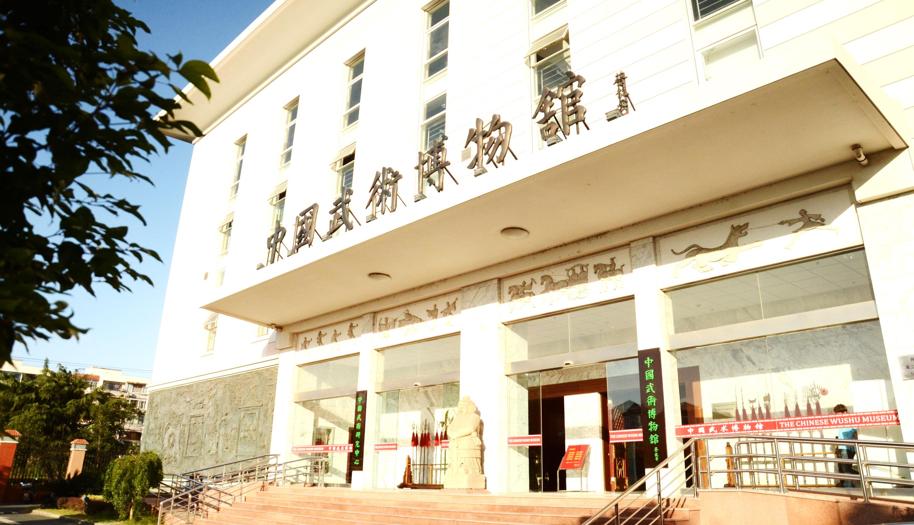
Thank you！

