Slide 1
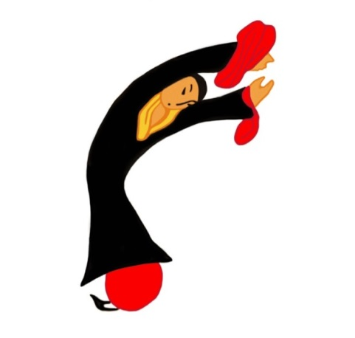
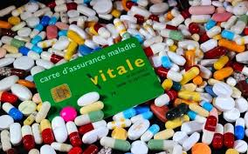
Qigong and occidental medicine: bridging the gap
Dr MP Guillaume
Internal Medicine, Sint Pieter Brussels hospital, Begium
Belgian Health Qigong Federation

Slide 2
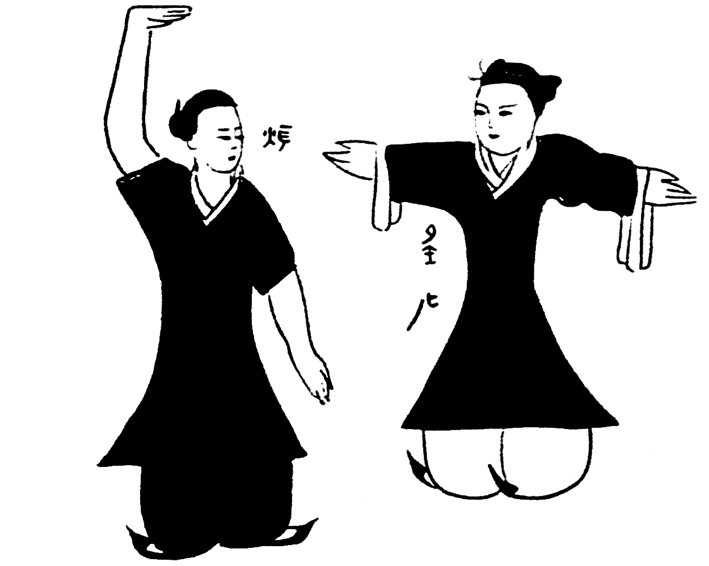
Traditional Chinese medicine is interested in imbalances of the human body as an entity, and treats the whole human body to restore its balance, the so called « qi », through different pathways including the practice of Qigong and Tai Chi
Whereas Occidental medicine has been convinced for two or three centuries that a disease is the result of the dysfunction of a particular biological mechanism and that drugs are intended to repair this dysfunction. Hence occidental medicine is still developing purified molecules coming from the pharmaceutical industry
Occidental medicine and traditional Chinese medicine have two fundamentally different approaches

Slide 3
Mind-body therapy in traditional Chinese medicine
In Chinese culture, Qigong, a practice developed for thousands of years, has been shown to be beneficial for physical health maintenance
It is one of the pillars of traditional Chinese medicine together with acupuncture, herbal medicine, massage, Tai Chi
It is a traditional form of Chinese medical exercise
It combines a range of specific and gentle static and dynamic repetitive movements easy to learn, breathing exercises and meditation in order to:
Help achieving
Well-being,
Health
Longevity
Prevent or slow down the progress of disease

Slide 4
Qigong exercise aims at
Harmonising the flow of vital energy
Regulating the functional activities of the body
Qigong is practiced in a variety of modern or traditional forms
There are thousands forms of Qigong practice. They have been developed by many specific teachers and schools in different regions of China over time
Despite a wide range of styles, it remains oriented towards health care and applies the same principles
It can be practiced anywhere, any time and do not require any special equipment

Slide 5
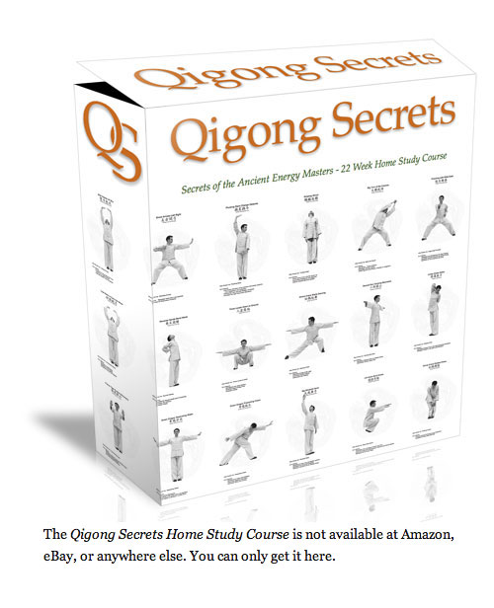
In Occident, Qigong is considered as a form of
mind-body therapy among others types of
complementary and alternative therapies (CAM)
In some European countries such as France, Qigong is include in the practice of some University Hospitals such as The Pitié-Salpêtrière Hospital
But in Belgium, medical practitioners have a very limited knowledge of Qigong, as it is not included in the course of their studies
The incorporation of such a therapy in their conventional medical practice is not widespread despite the growing evidence of its efficiency in the field of health

Slide 6
Clinical research application of the use of Qigong
A vast number of studies on health qigong have been implemented in China since the seventies but
Most reports were published in Chinese, hence it was difficult for international experts to comment these studies
Most of the publications were brief reports containing inadequate information for reproduction
Most of the trials involved a high risk of bias in many domains:
Inadequate sample size: small, potentially underpowered
No information about recruitment, heterogeneous populations
Nature of the control group, non-randomized design
Use of different style of Qigong
Quality of teachers
Significant variance in the practice duration and frequency
Difference in study duration : insufficient short-term follow-up: 5-12 weeks

Slide 7
Presumed physiologic mechanisms of response
This Chinese mindful practice involving body movement, breathing and clearing of the mind, promotes:
The reduction of stressful signals passed to the limbic system
The relaxation and the decrease of the sympathetic nervous system and the increase of the para-sympathic system activities
The improvement of cardiovascular and pulmonary function
The reduction of clinical somatic symptoms, anxiety, depression
The improvement of immune functions and vaccine-response
The increase of blood levels of endorphins
The reduction of levels of inflammatory markers and of circulating stress hormone (adrenocorticotropic hormone )

Slide 9
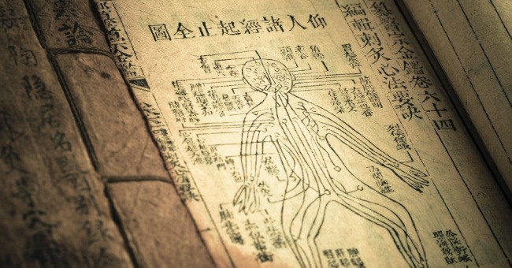
In the last decade, numerous studies have evaluated the effectiveness of Qigong for various conditions and symptoms such as:
- Stress management
- Insomnia
- Depression
- Substances abuse
- Fibromyalgia
- Survivors of torture and refugee trauma
- Balance problems, falls
- Parkinson’s disease
- Chronic low back pain
- Osteoarthritis of the knee
- Oncology
- Immunology
- Diabetes
- Hypertension
- Cardiac rehabilitation
- Respiratory rehabilitation

Slide 10
Managing Stress and Anxiety
Stress has become a worldwide problem
It affects people with different ages and backgrounds
It is induced by factors such as:
Workload
Studyload
Job instability
Family responsabilities
Conflicts
Stressful life events
Financial strains
Health problems
It has important economic implications
The most common reaction to stress is anxiety
Initially anxiety may be beneficial because it is a natural response and a necessary warning adaptation

Slide 12
Anxiety can become a pathologic disorder when it is excessive and uncontrollable, requires no specific external stimulus, and manifests with a wide range of physical and affective symptoms as well as changes in behavior and cognition
If intense and prolonged stress is not managed:
It can reduce-impair immune functions
It can lead to a range of health problems such as:
Depression
Fatigue
Insomnia
Headache
Stomach-ache
Problematic eating disorders
Cancer
Hypertension
Cardiovascular disease

Slide 13
The best way to manage stress and anxiety is through self-care
In the last years, many people have increasingly used mind-body exercises as complementary and alternative therapies
Qigong relieves anxiety and reduces stress among healthy people and patients
This practice is superior to ordinary aerobic exercises, because of additional components of mind and breathing
Regulation of diaphragmatic breath and structuring body movements during the practice, affects the autonomic nervous system (ANS) and the endocrine system, stabilizes the mood, enhances cardiac output - oxygen consumption – carbon dioxide exhalation

Slide 14
Regular practice of Qigong leads to:
Decrease in heart rate
Decrease in respiratory rate
Regulation of blood pressure
Change in blood biomarkers:
Decrease in the level of cortisol, adrenocorticotrophic hormone (ACTH) and aldosterone
Decrease in the level of neutrophilic white cells
Change in salivary biomarkers:
Increase in secretion of salivary immunoglobulin A
Decrease in salivary cortisol concentration
Correction of breathing errors, recovering of a proper breathing pattern
Decrease in oxygen consumption
Similar effect to anti-depressants including SSRI (serotonin selective re-uptake inhibitors):
The effect will manifest after some weeks, and fade over time with cessation of practice

Slide 15
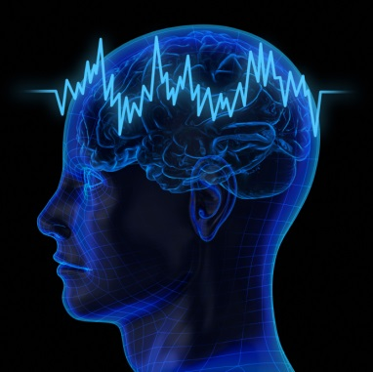
Applications in Neurology
Treatment and prevention of mental disorders:
number of studies with significant positive effects
There are several conditions for which the efficiency of Qigong has been clearly demonstrated:
Migraine - headache
Depression
Insomnia
For the following neurologic applications, evidences are limited due mostly to the poor quality of studies or the lack of studies:
Parkinson’s disease
Multiple Sclerosis
Stroke
Cognitive dysfunction

Slide 16
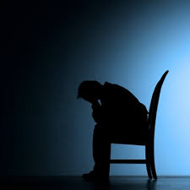
Depression
World Health Organization
In Europe
Depression is in the top ten causes of disability in 2014
Each year up to 25 % of the population suffer from anxiety or depression
It will be the 2nd most important cause of disability and the 2nd leading cause of disease burden worldwide by 2020
Predominant cause of illness and disability among teenagers
Is more debilitating than most of chronic physical diseases: Up to 50% of chronic sick leaves are due to anxiety/depression
About 50% of major depressions are not treated
The cost in the EU is about €170 billions per year

Slide 17
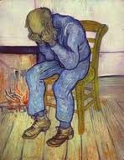
Prevalence rate of depression among the worldwide
elderly population: 3 to 15-40%
Elderly people suffering from chronic physical illnesses such as:
Parkinson’s disease
Diabetes
Cardiac or respiratory diseases
Stroke
Vision impairment
Are more vulnerable because of:
Their own disabilities
Reduced psychosocial resources: self-efficiency and sense of mastery
Incapacity to control many aspects of their live

Slide 18
The effectiveness of currently available antidepressants and psychotherapies are far from satisfactory :>30% of the patients fail to respond to those treatments
Furthermore, antidepressants may cause a wide range of side-effects in various organic systems, unacceptable by some patients
Alternative and complementary therapies are preferred by many patients for management of their symptoms:
Health Qigong is a safe form of therapy even for the frail elderly people, with very low chance of developing side effects
Reduction of disability
Increased psychosocial resources: self-efficiency
Reduction in depression
Improvement of well being

Slide 19
Etiology of Depression / effects of Qigong
Neuro-chemical hypothesis: monoamine hypothesis
Depression results from a lack of nor-epinephrine (NE) and serotonin (5-HT)
Antidepressants act by increasing the levels of these neurotransmitters in the synapse of the neurons in the relevant neuro-pathways
Qigong increases the level of monoamine neurotransmitters in the brain
Neuro-endocrine hypothesis
Stress will trigger signals in the Lymbic-Hypothalamus-Pituitary-Adrenal axis, with a release of glucocorticoids: cortisol
In normal condition: cortisol has a negative feedback on the HPA axis
In depression, there is an impairment of the negative feedback, with excessive activation of the HPA axis and a prolonged increased release of glucocorticoids
Qigong leads to down regulation of adrenal glucocorticoid
Helps the mind to calm down
Reduces the negative cognitive or affective signals to the brain
Reduce the release of cortisol

Slide 21
Chronic fatigue syndrome
Fibromyalgia: is a complex, medically poorly explained and debilitating condition
The prevalence ranges between 0,5% and 5% of adults
It is characterized by chronic widespread pain, fatigue, cognitive disturbances, sleep disorders, high amount of somatic and psychological distress
It is a challenging illness for patients and for health care providers
A large part of the patients remains unrecognized by general practitioners

Slide 22
Mechanisms involved include:
Genetic predispositions
Autonomic dysfunction
Altered pain processing in the central and peripheral nervous system
Emotional, physical, environmental stressors
No curative treatment is available
None of the conventional treatments explored so fare have shown a persistent or a significant outcome
Psychotropic and analgesic medications have limited clinical effects
Only cognitive behavior therapy and graded exercise therapy have been shown to be effective to reduce fatigue and associated symptoms
There is a growing use of CAM including:
Mind-body intervention
Exercise therapy
Qigong exercises
They have demonstrated positive effects on insomnia, fatigue, anxiety, depressive symptoms

Slide 23
The number of controlled trials on the effectiveness of Qigong exercise regarding the treatment of fibromyalgia is limited and the results of the studies are inconsistent
Qigong with meditation can reduce fatigue, depression, sleep disorders, pain
The benefits appear to be related to the amount of practice: there is a practice-response relationship: the patients who practiced the most had the best response
Unfortunately, the majority of participants didn’t continue to practice by themselves after the end of the study: the early improvement was not maintained

Slide 24
Older adults
Les Vieux de la vieille
Jean Gabin, Noël Noël et Pierre Fresnay

Slide 25
Older adults are commonly affected by chronic diseases
Physical exercise is recommended as the most universal and effective treatment and prevention for chronic illness and disability in aging
Selection of appropriate mode and intensity of exercise is necessary to minimize the possibility of exercise-induced stress while getting the full benefits of exercise
Increased oxidative stress due to a reduction in the body’s anti-oxidant defence system, elicit production and accumulation of oxidative damage to biological compounds such as lipid, protein and DNA resulting in the cellular senescence
Regular exercise can help to reduce oxidative stress by enhancing anti-oxidant capacity

Slide 26
Regular Qigong exercises:
Help to reduce the heart rate and cardiac workload
Improvement in strength of heart muscles, with increase of pre-ejection fraction
More efficient blood utilization in the tissues
Significant decrease in systolic and diastolic blood pressure
Improvement of heart rate variability
Increase level of HDL cholesterol among older adults
Help to prevent coronary artery disease
Impeding cholesterol accumulation in peripheral tissues
Difference in bone mineral density loss for female/sedentary group

Slide 27
Age-related decline in older people in their ability to respond to exercise is due to weaker muscle strength and slower reaction time
Improvement in physical performance:
Strength and flexibility
Posture stability
Improvement in the global measure of MMSE
The combined effects of physical and mental training on cognition such as with Qigong practice, are greater than either separately because each training affects different pathways
But there is an age dependency on the outcome effects
Exercises should be different than for younger subjects to obtain a similar amount of benefits
Increased duration and frequency
It takes at least a year of practice at a rate of three times a week to learn

Slide 28
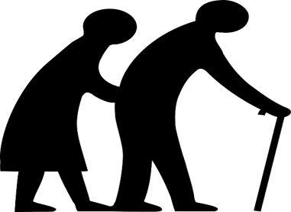
Qigong is a balance-based exercise
Improvement of axial symptoms such as postural stability
Increase of the maximum excursion
Reduced deviation in movements
Results are better/ the resistance-training and stretching groups
Directional control: measure of movement accuracy
Higher accuracy in kinesthetic sense of rotation of articulations
Improvement of lateral stability
Reducing of balance impairments and number of falls
Strength of bilateral knee extensors and flexors
Transition from a seated to a standing position and conversely
Gait velocity: stride length and walking velocity
Improvement of coordination, functional capacity, increased potential to perform daily life functions
Reach forward to take objects
The effects were maintained during 3 months after the intervention
Notes:
resistant-training programs: weighted-vests resistance, 1-2% of body weight, ankles weights

Slide 29
Parkinson’s disease
It is a progressive neurodegenerative disease characterized by:
Motor dysfunction:
bradykinetic movements,
resting tremor,
Difficulties to manage daily living activities due to reduced functional ability, rigidity
Lost of the ability to maintain standing balance and lower extremity impairments lead to:
Lost of postural stability
Increased risk of falling
Gait dysfunction, with short steps
Less responsive to medication, requires alternatives approaches
So, management of Parkinson’s disease requires exercises
It is proved that physical activities delay the deterioration of motor functions and prolong functional independence

Slide 30
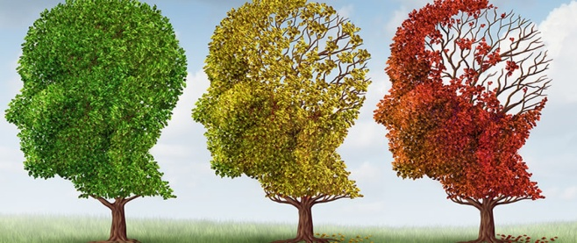
Cognitive function of subjects at risk of progressive decline
20% of people aged 65 years and more have at least mild cognitive impairment, with a risk to develop dementia of 10% per year
This contributes to decreased quality of live, increased neuropsychiatric symptoms and increased disability = healthcare costs
The association of physical and mental challenges may have an additive effect on brain health and cognitive function
Exercise can provide cognitive benefits and are recommended as a therapy:
Sustained improvements in global cognitive functioning such as
Executive function
Memory
Learning
Because Qigong engages significant spatial-temporal orientation, memory, executive control resources, attention
Improvement in delayed recall
Improvement of subjective complaints

Slide 31
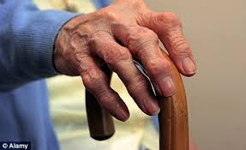
Chronic musculoskeletal disorder: Osteoarthritis
It is the most common joint disorder among adults worldwide
It is due to a cartilage destruction, with spasm of surrounding muscles and loss of flexibility of the tendons and ligaments
It commonly affects the hip, the knee, hand joints and backbones
Symptoms are pain, muscle weakness and physical dysfunction
It is a major cause of disability in the aging population
Symptomatic in 10% of men and 18% of women aged 60 years or more
80% limitations in movements
25% report inability to perform major daily live activities of life
There is no cure. Treatment options could include non- pharmacological therapies in order to
Alleviate pain
Maintain-improve joint mobility
Increase the muscle strength

Slide 32
Effects of qigong on management of Knee osteoarthritis
Stronger muscles and better coordination:
Improve the stability of the knee,
Reduce pain and stiffness
Improve aerobic capacity: 6-minutes walk test

Slide 33
Oncology
WHO’s data
Cancer is a leading cause of death worldwide
8.2 million people worldwide died from cancer in 2012
60% of world’s total new annual cases occur in Africa,
Asia and Central and South America
In high-income countries,
70% of deaths are among people
aged 70 years and older
People predominantly die
of chronic diseases:
Cardiovascular diseases
Cancers
Dementia
Chronic obstructive lung disease
Diabetes

Slide 34
Prevention
30% of cancers could be prevented, in particular by:
Tobacco smoking:
Is the single greatest avoidable risk factor for cancer mortality worldwide, causing an estimated 22% of cancer deaths per year
Causes many types of cancer, such as : cancers of the lung, oesophagus, larynx (voice box), throat, kidney, bladder, pancreas, stomach and cervix
Responsible of 70% of the lung cancer
Alcohol use
Diets: high in fruits and vegetables may have a protective effect against many cancers. Conversely, excess consumption of red and preserved meat may be associated with an increased risk of colorectal cancer
Regular physical activity and the maintenance of a healthy body weight, along with a healthy diet, will considerably reduce cancer risk

Slide 35
Cancer patient care
Advances in medical technology and cancer treatment improved the 5-year survival rate of all cancer sites: 65.8%
Cancer represent a major lifetime stressor for patients
Emotional distress of diagnosis
Use of medical technology
Persistence of side-effects of treatment
Physical activity is recommended to:
Reduce symptoms
Increase exercise tolerance
Improve quality of life
Potentially reduce length of stay and post-operative complications

Slide 36
Severe fatigue is one of the most common cancer-related symptoms
It is defined as a subjective sense of physical, emotional and/or cognitive tiredness
The underlying causes remain not well understood
Contributing factors:
Cancer treatment: chemotherapy, radiotherapy, androgen deprivation therapy for prostate cancer
Anaemia
Psychological distress
Pain
Nutritional deficit
Sleep disturbance
Decreased functional status
May persist for months to years following treatment
Diminish quality of life, limiting daily life activities

Slide 37
Qigong has health benefits
Qigong could play a role to control symptoms associated with cancer and cancer treatment
Improves muscular and mobility functioning for different cancer types
might improve shoulder muscular strength, mobility and functional capacity post mastectomy-radiotherapy
Improves neck mobility, maintain temporo-mandibular and shoulder joints mobility after aggressive treatment of nasopharyngeal cancer with neck muscles fibrosis, trismus, restricted mouth opening capacity, shoulder dysfunctions
Improvement of post-operative pulmonary functions in lung cancer
Better management of anxiety symptoms, sleep disorders
Reduction of depressive symptoms
Notes:
Orl: Radiotherapy, chemotherapy, nasopharyngectomy

Slide 38
Anticancer property
Exhibits potent cytotoxic effects on pancreatic cancer cells, prostate cancer cells, breast cancer cells
Induces cell death (apoptosis) of small-cell lung cancer cells by up-regulation
Down-regulation of oncogenes MYCL1 and DEK expression by SCLC cells
Down-regulation of cell migration regulation genes
Improvement of the immune function of patients compared to patients treated with a conventional method only
Reduction of inflammatory markers: CRP and cortisol
Better level of white blood cells after chemotherapy (decrease neutropenia)
Notes:
Faut études pour préciser mécanisme/immunité

Slide 39
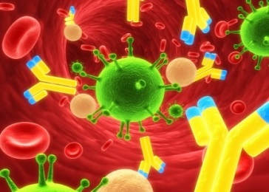
Immunology
Influenza
>65 years: age-related immune-deregulation with increased susceptibility to infection, longer recovery and a defective development of protective level of antibodies to the Flu vaccine
Qigong:
Increases the magnitude and the duration of the response to the Influenza Vaccine in older adults
Age-related immune dysfunction due to excessive lymphocyte apoptosis ( increase sensitivity of lymphocytes to death signal)
Qigong:
Promotes renewal and regeneration of Lymphocytes
Lower level of mild and severely damaged DNA > effective DNA repair mechanism
Modulates the level of Interleukin-6, an important marker of inflammation

Slide 40
Pulmonary Rehabilitation Program
Clinical utility of exercises is recognized in the managements of patients with chronic obstructive disease (COPD)
Many issues remain unresolved: The best strategies is not yet defined
Optimal intensity, specific modalities
Interplay among subjects characteristics (disease severity, muscle wasting) on exercise practice
Qigong may be practiced in complement to the rehabilitation centre
Qigong exercises are more benefit for the air-trapping and airflow limitation caused by COPD/ conventional exercises
Improves exercise capacity including the six-minute walking distance from 298 to 349 meters
Increases 11% the mean forced expiratory volume in the first second Decrease in the number of exacerbations
May be practiced at home

Slide 41
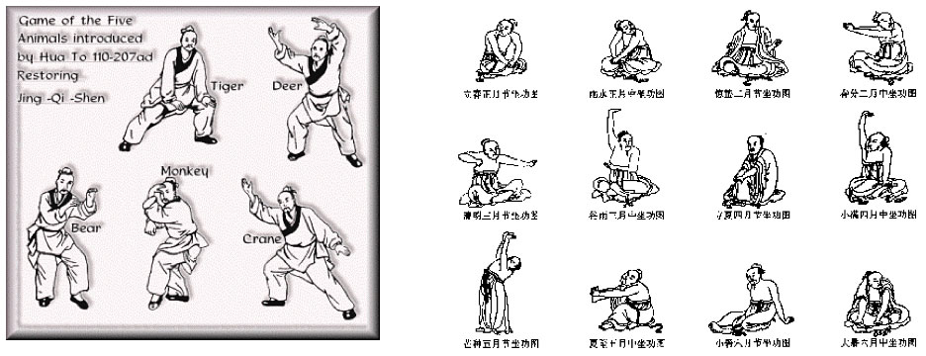
Wuqinxi, Five Animals
The Qigong Wuqinxi originated in ancient times
The famous Chinese physician Hua Tuo in Han Dynasty compiled the “Five Animal Form” in the second century A.D.
The form mimics the movements of the tiger, bear, deer, monkey, and bird to facilitate the cultivation of Qi and spirit by the practitioners.
The practitioner attempts to integrate and harmonize breath, posture and movements

Slide 42
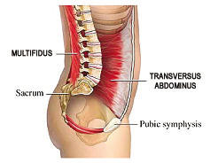
Wuqinxi exercises: Is beneficial
for obese old people
Promotes blood antioxidant enzymes activities
Decrease oxidative injury
Enhances lipid peroxidation
Decrease blood lipids levels:
Total cholesterol, Triglyceride, LDL-cholesterol
Increases intestinal bacteria count
Low back pain is a very common and worldwide chronic disease with imbalance of the trunk muscle strength: flexor muscle > extensor muscle strength
Reduces the flexion-extension ratio (FER), an objective parameter to evaluate trunk muscle balance
Improves the function of the lumbosacral multifidus muscle,
an extensor muscle which is one of the smallest yet most
“powerful” muscle that gives support to the spine

Slide 43
Studies about effects of Baduanjin exercises
This Qigong has more than thousand years of history in China, also known as “the eight section brocades” ,composed of 8 set of actions
It is a typical mind-body exercise which promotes health
It is widely popular in China, but not recognized worldwide as Tai Chi
It is easier to learn and less physically and cognitive demanding than Tai Chi
It is a low level aerobic exercise
It involves movements and activation of every part of the body, including all the movable joints and voluntary muscles

Slide 44
Has a wide variety of beneficial effects
Enhancement in quality of life, mental health for a variety of participants, program: 30min 3times a week during 12-16 weeks
Physical function: Enhances respiratory function
Social function
Modulating mind and spirit
Reduces oxidative stress :
Increases the activities of antioxidant enzymes
Reduces oxidants production
Maintains a steady gravity centre
With the lumbar spine as the axis
The movements of the four limbs are driven
Enhances lumbar muscles strength and lumbar proprioceptive function

Slide 45
Osteoarticular
Improves physical flexibility
Promotes the motion of the shoulder joint and sacroiliac joint
Provides a safe auxiliary treatment option for patients with osteoarthritis
Reduction of pain, stiffness, disability
Improvement of muscular strength of the quadriceps reduce the risk of developing knee OA ( weakness of the quadriceps put at risk for further pain , progression of joint damage)
Prevents bone loss commonly occurring in middle-aged women
Interleukin-6 (IL-6) is a strong stimulator of osteoclasts
The decline of estrogen reduces his inhibitory effect on IL-6 activity

Slide 46
Hyperlipidemia
a major risk factor for cardiovascular disease
Reduces the accumulation of subcutaneous adipose, but is not enough to control the abdominal obesity
Improves blood lipid metabolism implicated in the development of atherosclerosis, reducing cardiovascular morbidity and mortality
Promotes synthesis of HDL-Cholesterol
Long time training promotes the consumption of lipids by elevation of the ratio of the energy supply from lipid oxidation
Significantly decreases the levels of Total cholesterol, Triglyceride, LDL-Cholesterol, and increases plasma HDL-C levels
Among healthy adults and non-treated patients, in comparison with no-exercise
But has no advantage compared to other exercises
Improves insulin sensitivity
Reduction of the levels of blood sugar and glycosylated haemoglobin
Notes:
Small size of samples: 12-126 persons, problems of methodology

Slide 47
In older adults
Improves overall sleep quality (48%), and subscales of sleep quality :
Subjective sleep
Sleep latency
Sleep duration
Sleep efficiency
Use of hypnotics
Patient feeling more rested in the morning
Quickly improves sleep quality after 4 weeks of practice, and maintains throughout the 12 weeks of intervention
Improves the body morphology: strength, flexibility and balance
Notes:
Age moyen 71 ans

Slide 48
Hypertension
Improves Blood pressure after at least 3 months of practice
When used alone,
Decreases by 13mmHg the systolic blood pressure
Decreases by 6,13mmHg the diastolic blood pressure
But no significant additional antihypertensive effect compared to antihypertensive drugs
When used in combination with antihypertensive drugs
Small but significant reduction on systolic blood pressure: 7,49mmHg and diastolic blood pressure 3,55mmHg compared to antihypertensive drugs alone
Baduanjin is an effective and relatively safe complementary therapy to control hypertension
Enhances the effect of antihypertensive drugs

Slide 49
In conclusion
Regular practice of Qigong, and in particular of Health Qigong would be good for health and quality of life
Health Qigong such as Baduanjin is easy to practice in particular among older adults
Its benefits may be quickly realized
Therefore, it can be practiced as a defensive art, as an art of health or an art of life
And it can be used as a complementary therapy to occidental medicine

Slide 50
Occidental medicine could develop synergies with Chinese medicine through qigong, particularly in the management of chronic diseases and serious illnesses
The road will be long

Slide 51
People present today can help to bridge the gap

