Slide 1
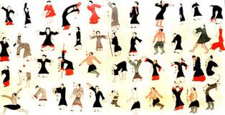


Qigong and occidental medicine
Dr MP Guillaume
Internal Medicine Unit
Saint-Pierre University Hospital, Brussels, ULB, Belgium
Belgian Health Qigong Federation

Slide 2
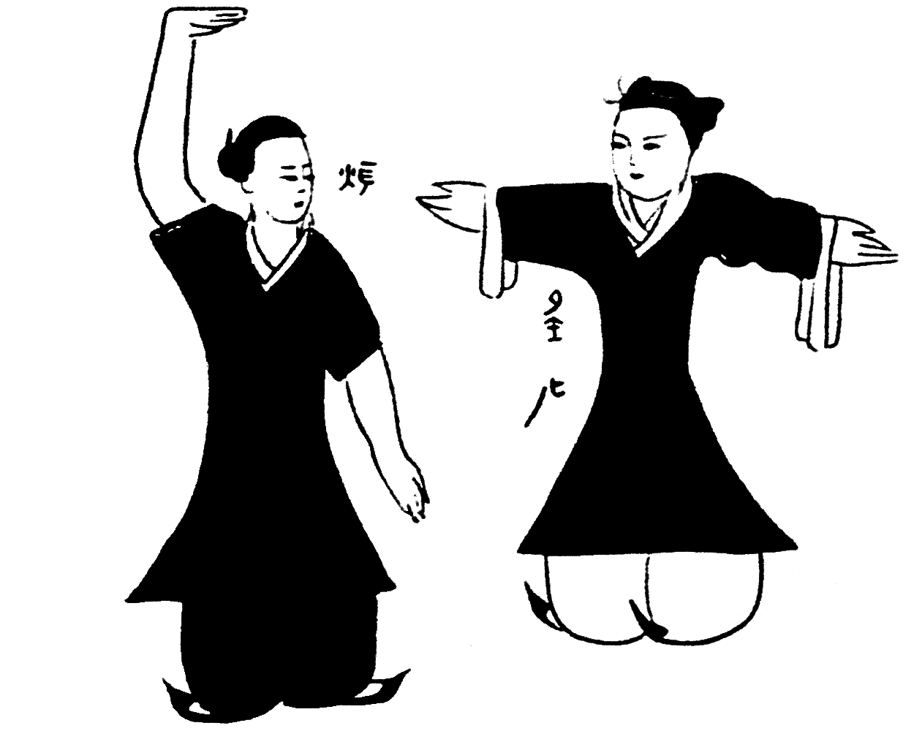
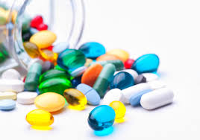
Occidental medicine and traditional Chinese medicine have two fundamentally different approaches
Occidental medicine has been convinced for two or three centuries that a disease is the result of the dysfunction of a particular biological mechanism and that drugs are intended to repair this dysfunction. Hence, occidental medicine is still developing purified molecules coming from the pharmaceutical industry
Traditional Chinese medicine is interested in imbalances of the human body as an entity, and treats the whole human body to restore its balance, the so called « qi », through different pathways, including the practice of Qigong and Tai Chi

Slide 3
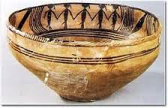
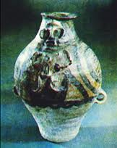
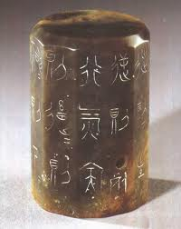
In Chinese culture, Qigong, an ancestral body practice developed for thousands of years, has been shown to be beneficial for physical health maintenance
Pottery > 5000 years old in the Qinghai province
  Pot: black people dancing and stretching their limbs = guidance to get the blood and the energy flowing
  Piece of pottery: hybrid human being, male upper body-female lower body (union of the yin and the yang in the same person) who performs breath exercises with open mouth
The oldest text about Qigong was found on a jade pendant dated from 600 years BC
  Describes « the control of the breath”, energetic practices by exercises

Slide 4
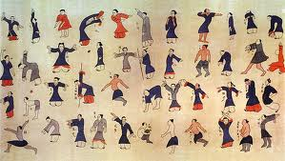
The most important archaeological discovery regarding Qigong, was a silk painting found in 1973 in Ma Wang Dui, province of Hunan
It includes forty-four body postures
illustrating Daoyin
(precursor of Qigong , combining
stretching exercises and self massages)
going with inscriptions outlining:
  Either the therapeutic significance of the movement :
    mainly musculoskeletal and digestive disorders
    but also genital diseases, deafness, knee pain, …
  Or similarities with the posture of an animal:
    wolf, bear, monkey, crane, dragon, falcon, which are all animals of the Taoïst mythology that followers of longevity tried to mimic.
These illustrations seem to point out that Qigong exercises were widely used to treat diseases in ancient China

Slide 5
Mind-body therapy in traditional
Chinese medicine
At the outset of the 21 st century, it remains one of the pillars of traditional Chinese medicine together with herbal medicine, dietetics, acupuncture-moxibustion, massage-Tui Na
It combines :
  Body postures such as standing or sitting
  A range of specific repetitive movements easy to learn
  Breathing exercises to accompany the postures or movements
  Meditation to achieve a focused state of relaxed awareness
Qigong exercise aims at:
  Harmonising the flow of vital energy
  Regulating the functional activities of the body
  Help achieving : Well-being, health and longevity
  Prevent or slow down the progress of disease

Slide 6
Qigong is practiced in a variety
of modern or traditional forms
  There are thousands forms of Qigong practice
    They have been developed by many specific teachers and schools in different regions of China over time
    They have been subject to updating by various Chinese University Institutes
  Despite a wide range of styles, it remains oriented towards health care and applies the same principles
Qigong can be practiced :
  Anywhere, any time and do not require any special equipment
  Alone or with a group: take part to the reintegration of isolated individuals

Slide 7

In Occident, Qigong is considered as a form of
mind-body therapy among others types of
complementary and alternative therapies (CAM)
In Europe
  In France
    Qigong is include in the practice of some University Hospitals such as The Pitié-Salpêtrière Hospital >2011
  In Germany
    Pr Willy Neumann of the Neubrandenburg University created a Health Qigong Master’s degree
    Qigong :
      Is recognized as a health sport
      Is reimbursed by the social security as preventive medicine
  In Belgium
    Most of the medical practitioners have a very limited knowledge of Qigong, as it is not included in the course of their studies
    The incorporation of such a therapy in their conventional medical practice is not widespread despite the growing evidence of its efficiency in the field of health

Slide 8
Clinical research application of the use of Qigong
A vast number of studies on health Qigong have been implemented in China since the seventies but
  Most reports were published in Chinese, hence it was difficult for international experts to comment these studies
  Most of the publications were brief reports containing inadequate information for reproduction
Most of the trials involved a high risk of bias in many domains:
  Inadequate sample size: small, potentially underpowered
  No information about recruitment, heterogeneous populations
  Nature of the control group, non-randomized design
  Use of different style of Qigong
  Quality of teachers
  Significant variance in the practice duration and frequency
  Difference in study duration : insufficient short-term follow-up: 5-12 weeks

Slide 9
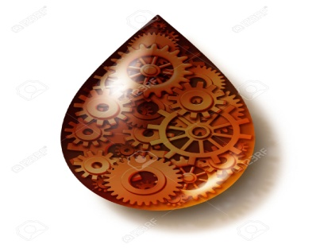
Presumed physiologic mechanisms of response
This Chinese mindful practice involving body movement, breathing and clearing of the mind, promotes:
The reduction of stressful signals passed to the limbic system
The relaxation and the decrease of the sympathetic nervous system activity and the increase of the para-sympathic nervous system activity
The improvement of cardiovascular and pulmonary functions
The reduction of clinical somatic symptoms, anxiety, depression
The improvement of immune functions and vaccine-response
The increase of blood levels of endorphins
The reduction of levels of inflammatory markers and of circulating stress hormone (adrenocorticotropic hormone )

Slide 10
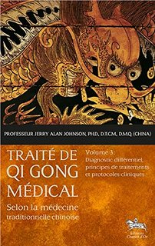
In the last decade, numerous studies have evaluated the effectiveness of Qigong for various conditions and symptoms such as:
- Stress management
- Insomnia
- Depression
- Substances abuse
- Chronic fatigue syndrome
- Survivors of torture and refugee trauma
- Balance problems, falls
- Parkinson’s disease
- Chronic low back pain
- Osteoarthritis of the knee
- Oncology
- Immunology
- Diabetes
- Hypertension
- Cardiac rehabilitation
- Respiratory rehabilitation

Slide 11
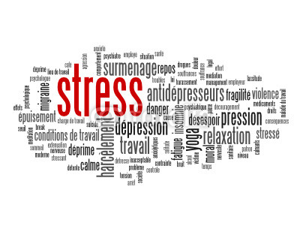
Managing Stress and Anxiety
Stress has become a worldwide problem
It affects people with different ages and backgrounds
The most common reaction to stress is anxiety
  Initially anxiety may be beneficial because it is a natural response and a necessary warning adaptation
  Anxiety can become a pathologic disorder when it is excessive and uncontrollable,
    requires no specific external stimulus
    manifests with a wide range of physical and affective symptoms as well as changes in behavior and cognition
If intense and prolonged stress is not managed:
  It can reduce – impair immune functions
  It can lead to a range of health problems such as:
    fatigue, insomnia, headache, depression, stomach-ache, problematic eating disorders, hypertension, cardiovascular disease, ...

Slide 12
The best way to manage stress and anxiety is through self-care
In the last years many people have increasingly used mind-body exercises as complementary and alternative therapies
Qigong relieves anxiety and reduces stress among healthy people and patients
  This practice is superior to ordinary aerobic exercises, because of additional components of mind and breathing
  Regulation of diaphragmatic breath and structuring body movements during the practice, affects the autonomic nervous system (ANS) and the endocrine system, stabilizes the mood, enhances cardiac output - oxygen consumption – carbon dioxide exhalation
  Change in blood biomarkers:
    Decrease in the level of cortisol, adrenocorticotrophic hormone (ACTH) and aldosterone
    Decrease in the level of neutrophilic white cells

Slide 13
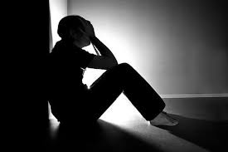
Depression
World Health Organization
In Europe
  Depression is in the top ten causes of disability in 2014
  Each year up to 25 % of the population suffer from anxiety or depression
  It will be the 2nd most important cause of disability and the 2nd leading cause of disease burden worldwide by 2020
  Predominant cause of illness and disability among teenagers
  Prevalence rate of depression among elderly population: 3 to 15-40%
  Is more debilitating than most of chronic physical diseases: Up to 50% of chronic sick leaves are due to anxiety/depression
About 50% of major depressions are not treated
The cost in the EU is about €170 billions per year

Slide 14
  The effectiveness of currently available antidepressants and psychotherapies are far from satisfactory : > 30% of the patients fail to respond to those treatments
Furthermore, antidepressants may cause a wide range of side-effects in various organic systems, unacceptable by some patients
Alternative and complementary therapies are preferred by many patients for management of their symptoms:
Health Qigong is a safe form of therapy even for the frail elderly people, with very low chance of developing side effects
  Reduction of disability
  Increased psychosocial resources: self-efficiency
  Reduction in depression
  Improvement of well being

Slide 15
Etiology of Depression / effects of Qigong
Neuro-chemical hypothesis: monoamine hypothesis
  Depression results from a lack of nor-epinephrine (NE) and serotonin (5-HT)
  Antidepressants act by increasing the levels of these neurotransmitters in the synapse of the neurons in the relevant neuro-pathways
Qigong increases the level of monoamine neurotransmitters in the brain
Neuro-endocrine hypothesis
  Stress will trigger signals in the Lymbic-Hypothalamus-Pituitary-Adrenal axis, with a release of glucocorticoids: cortisol
  In normal condition: cortisol has a negative feedback on the HPA axis
  In depression, there is an impairment of the negative feedback, with excessive activation of the HPA axis and a prolonged increased release of glucocorticoids
Qigong leads to down regulation of adrenal glucocorticoid
  Helps the mind to calm down
  Reduces the negative cognitive or affective signals to the brain
  Reduce the release of cortisol

Slide 16
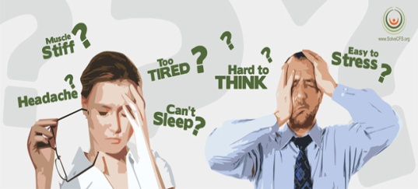
Chronic fatigue syndrome, myalgic encephalomyelitis
Definition: “medically unexplained” fatigue lasting for ≥ 6 months
It is a complex, medically poorly explained and debilitating condition
The prevalence ranges between 0,007 % and 3% in the general adults population
It is characterized by chronic widespread pain, fatigue, cognitive disturbances, sleep disorders, high amount of somatic and psychological distress that affect daily functioning
It is a challenging illness for patients and for health care providers
A large part of the patients remains unrecognized by general practitioners

Slide 17

The etiopathogenesis remains mis understood, with multi-factorial disease pathways
Mechanisms involved include:
  Genetic predispositions
  Physiological factors
    Autonomic dysfunction
    Altered pain processing in the central and peripheral nervous system
  Emotional, physical, environmental stressors:
    Increased occurrence of recent stressful life events
    Increased chronic stress levels
No curative treatment is available
  None of the conventional treatments explored so fare have shown a persistent or a significant outcome
  Psychotropic and analgesic medications have limited clinical effects

Slide 18
Only cognitive behaviour therapy and graded exercise therapy have been shown to be effective to reduce fatigue and associated symptoms
There is a growing use of CAM including:
  Mind-body intervention
  Exercise therapy
  Qigong exercises
  Studies have demonstrated that Qigong exercises may improve Chronic fatigue syndrom:
  Positive effects on insomnia, fatigue, anxiety, depressive symptoms
  An improvement of the psychological quality of life and spiritual well-being
  The benefits appear to be related to the amount of practice: there is a practice-response relationship: patients who practiced the most had the best response
  Qigong has an effect on telomeres and improves the telomerase activity

Slide 19
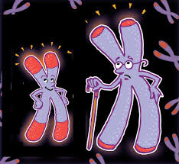
Telomeres are DNA sequences at the ends of the chromosomes, that ensure chromosomal stability overtime
They shorten with each cell division, or under oxidative stress
The length of telomere is used as a biomarker: Shortened telomere is a marker of
  Disease risk-progression
  Premature mortality
Telomerase extends telomere length and protects the chromosomes
Shortened telomeres and lower telomerase activity were observed during Chronic fatigue syndrome
Recent studies suggest that telomerase activity may be improved by intensive meditation training, physical exercises and life style changes

Slide 20
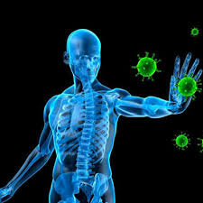
Immuno-modulatory effects on immune response
Qigong modulates the peripheral circulation of immune blood cells
  Increase in B lymphocytes, an important component of adaptive immunity, with proliferation-production of antibodies in response to pathogens
Qigong: Increases the magnitude and the duration of the response to the Influenza Vaccine in older adults
Age-related immune dysfunction due to excessive lymphocyte apoptosis (increase sensitivity of lymphocytes to death signal), Qigong:
  Promotes renewal and regeneration of Lymphocytes
  Lower level of mild and severely damaged DNA > effective DNA repair mechanism
Modulates the level of Interleukin-6, an important marker of inflammation

Slide 21
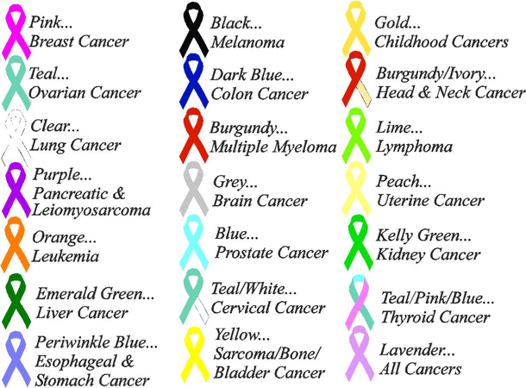
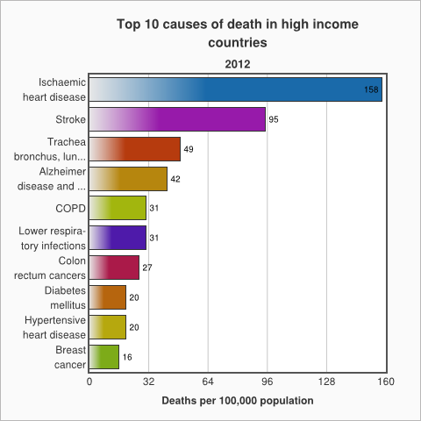
Oncology
WHO’s data
Cancer is a leading cause of death worldwide
8.2 million people worldwide died from cancer in 2012
60% of world’s total new annual cases occur in Africa,
Asia and Central and South America
In high-income countries,
  70% of deaths are among people
  aged 70 years and older
  People predominantly die
  of chronic diseases:
    Cardiovascular diseases
    Cancers
    Dementia
    Chronic obstructive lung disease
    Diabetes

Slide 22
Prevention
30% of cancers could be prevented, in particular by:
  Regular physical activity
  The maintenance of a healthy body weight, along with a healthy diet, no smoking, no alcohol consumption
  will considerably reduce cancer risk
Cancer patient care
Physical activity is recommended to:
  Reduce symptoms
  Increase exercise tolerance
  Improve quality of life
  Potentially reduce length of stay and post-operative complications

Slide 23
Qigong has health benefits
Qigong could play a role to control symptoms associated with cancer and cancer treatment
    Improves muscular and mobility functioning for different cancer types
      Might improve shoulder muscular strength, mobility and functional capacity post mastectomy-radiotherapy
      Improves neck mobility, maintain temporo-mandibular and shoulder joints mobility after aggressive treatment of nasopharyngeal cancer with neck muscles fibrosis, trismus, restricted mouth opening capacity, shoulder dysfunctions
      Improvement of post-operative pulmonary functions in lung cancer
Better management of anxiety symptoms, sleep disorders
Reduction of depressive symptoms
Notes:
Orl: Radiotherapy, chemotherapy, nasopharyngectomy

Slide 24
Has anti-cancer property
  Exhibits potent cytotoxic effects on pancreatic cancer cells, prostate cancer cells, breast cancer cells
  Induces cell death (apoptosis) of small-cell lung cancer cells ( breast, pancreas, prostate)
    Down-regulation of oncogenes MYCL1 and DEK expression by SCLC cells
    Increase in apoptotic genes levels DAPK2 and CIDE-B
      ↓
    Inhibiting proliferation of cancer cells, leading to cell death
Improvement of the immune function of patients compared to patients treated with a conventional method only:
  Reduction of inflammatory markers: CRP and cortisol
  Better level of white blood cells after chemotherapy (decrease neutropenia)
  Stimulates proliferation of PBMCs and their cytotoxic activity/NSCLC
  Increase in Natural Killer cells
Notes:
Faut études pour préciser mécanisme/immunité

Slide 25
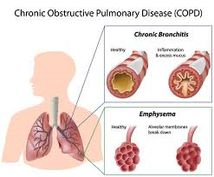
COPD:Pulmonary Rehabilitation Program
Clinical utility of exercises is recognized in the managements of patients with chronic obstructive disease (COPD)
  Qigong is a low-intensity level aerobic exercise, more appropriate to COPD than high-intensity exercises which might get worse systemic inflammatory response and cause muscular cachexia
  Qigong may be practiced in complement to the rehabilitation program
  Qigong exercises are more benefit for the air-trapping and airflow limitation caused by COPD/ conventional exercises
    Decreases symptoms such as dyspnoea
    Increases 11% the mean forced expiratory volume in the first second
    Improves exercise capacity including the six-minute walking test
    Decrease in the number of exacerbations
    May be practiced at home

Slide 26
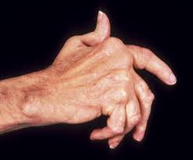
Chronic musculoskeletal disorder: Osteoarthritis
It is the most common joint disorder among adults worldwide
It is due to a cartilage destruction, with spasm of surrounding muscles and loss of flexibility of the tendons and ligaments
It commonly affects the hip, the knee, hand joints and backbones
Symptoms are pain, muscle weakness and physical dysfunction
It is a major cause of disability in the aging population
    Symptomatic in 10% of men and 18% of women aged 60 years or more
    80% limitations in movements
    25% report inability to perform major daily live activities of life
There is no cure. Treatment options could include non- pharmacological therapies in order to
  Alleviate pain
  Maintain-improve joint mobility
  Increase the muscle strength

Slide 27
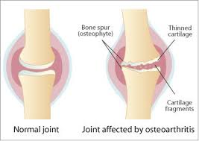
Effects of qigong on management of Knee osteoarthritis
Stronger muscles
Better coordination of muscles
  Improve the stability of the knee
  Reduce pain and stiffness
  Improve aerobic capacity: 6-minutes walk test

Slide 28
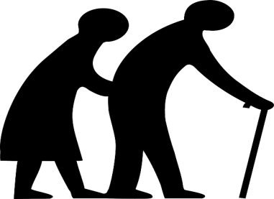
Older adults are commonly
affected by chronic diseases
Physical exercise is recommended as the most universal and effective treatment and prevention for chronic illness and disability in aging
  Age-related decline in older people in their ability to respond to exercises is due to weaker muscle strength and slower reaction time
Selection of appropriate mode and intensity of exercise is necessary Exercises should be different than for younger subjects
  To minimize the possibility of exercise-induced stress while getting the full benefits of exercise
  To obtain a similar amount of benefits
    Increased duration and frequency
    It takes at least a year of practice at a rate of three times a week to learn
Regular exercises, by enhancing anti-oxidant capacity, can help to reduce oxidative stress which elicit production and accumulation of oxidative damage to biological compounds (protein and DNA) resulting in the cellular senescence

Slide 29
Regular Qigong exercises:
Help to reduce the heart rate and cardiac workload
  Improvement in strength of heart muscles, with increase of pre-ejection fraction
  More efficient blood utilization in the tissues
  Significant decrease in systolic and diastolic blood pressure
  Improvement of heart rate variability
Increase level of HDL cholesterol among older adults
  Help to prevent coronary artery disease
  Impeding cholesterol accumulation in peripheral tissues
Difference in bone mineral density loss for females / sedentary group
Improvement in physical performance:
  Strength and flexibility
  Posture stability
But there is an age dependency on the outcome effects

Slide 30
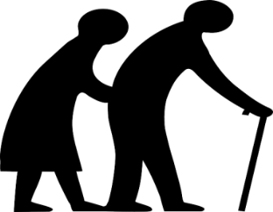
Qigong is a balance-based exercise
  Improvement of axial symptoms such as postural stability
    Increase of the maximum excursion
      Reduced deviation in movements
      Results are better/ the resistance-training and stretching groups
    Directional control: measure of movement accuracy
      Higher accuracy in kinesthetic sense of rotation of articulations
      Improvement of lateral stability
  Reducing of balance impairments and number of falls
    Strength of bilateral knee extensors and flexors
    Transition from a seated to a standing position and conversely
    Gait velocity: stride length and walking velocity
  Improvement of coordination, functional capacity, increased potential to perform daily life functions
    Reach forward to take objects
Notes:
resistant-training programs: weighted-vests resistance, 1-2% of body weight, ankles weights

Slide 31
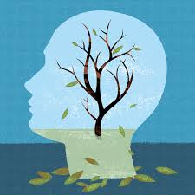
Cognitive function of subjects at risk of progressive decline
The population is aging, by the year 2030 the number of people older than 65 will almost double
Although there is a wide variability in the aging process, cognitive dysfunction are common including:
  Decline in executive function
  Decline in information processing speed
  Decline in attention
20% of people aged 65 and more have at least mild cognitive impairment, which
  Causes minor but noticeable changes and abnormal findings in ≥ 1 cognitive domains
  with a 10% risk per year to develop the most severe endpoint: dementia
    This contributes to decreased quality of life, increased neuropsychiatric symptoms and increased disability = health care costs

Slide 32
Strategies are needed:
  To maintain or improve cognitive function
  To prevent cognitive decline,
  To preserve functional ability, independence and quality of life
Exercise can provide cognitive benefits and is recommended as a therapy:
  Sustained improvements in global cognitive functioning such as
    Executive function
    Memory
    Learning
The biological mechanisms of action of exercise include changes at different levels :
  Promotes angiogenesis, synaptic connectivity,...
The association of physical and mental challenges such as Qigong, may have an additive effect on brain health and cognitive function because each training affects different pathways

Slide 33
Qigong improves executives functions in cognitively intact adult
    Executive function is a global term for processes that regulate-control-manage cognitive functions such as:
      Working memory
      Attention
      Problem solving
      Verbal reasoning
      Mental flexibility
      Task switching
      Initiation and monitoring of actions
Executive function is a key component of healthy balance and postural control
Effect sizes were equivalent to those obtained with other exercises and cognitive training

Slide 34
    Because Qigong engages significant spatial-temporal orientation-memory-executive control resources-attention, it improves in cognitive impaired adults:
  Subjective complaints
  Executive functions
    Mechanisms implicated:
      Neurophysiological changes such as:
        Increased brain derived neurotrophic factor and plasticity
  It reduces anxiety and depression > impact on cortisol and other stress-related pathways of cognitive decline
  Trains agility, mobility, dynamic postural control
  Training in sustained attention focus, shifting and multi-tasking : could help train working memory, divided attention, cognitive flexibility and overall executive function

Slide 35
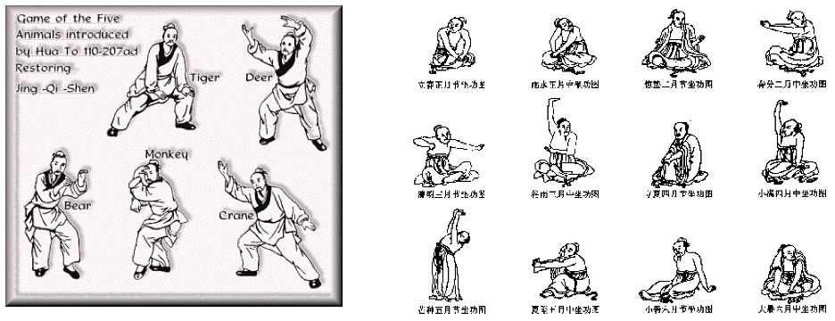
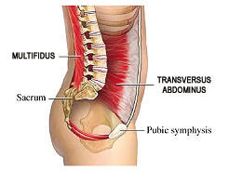
Wuqinxi, Five Animals
Originated in ancient times
The famous Chinese physician Hua Tuo in Han Dynasty compiled the “Five Animal Form” in the second century A.D.
The form mimics the movements of the tiger, bear, deer, monkey, and bird to facilitate the cultivation of Qi and spirit by the practitioners.
For obese old people
    Promotes blood antioxidant enzymes activities, decrease oxidative injury
    Enhances lipid peroxidation: decrease blood lipids levels
    Increases intestinal bacteria count
  Low back pain > imbalance of the trunk muscle strength: flexor muscle > extensor muscle strength
  Improves the function of the lumbosacral multifidus muscle,
  an extensor muscle which is one of the smallest yet most
  “powerful” muscle that gives support to the spine

Slide 36
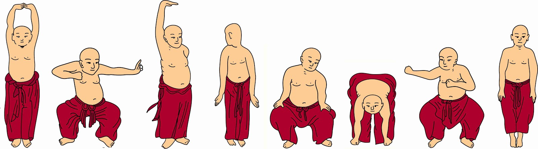
Baduanjin, the eight section brocades
This Qigong has more than thousand years of history in China
It is easier to learn and less physically and cognitive demanding than Tai Chi
It is a low level aerobic exercise
It involves movements and activation of every part of the body, including all the movable joints and voluntary muscles
  Improves physical flexibility
  Promotes the motion of the shoulder joint and sacroiliac joint
Maintains a steady gravity centre
  With the lumbar spine as the axis
  The movements of the four limbs are driven
  Enhances lumbar muscles strength and lumbar proprioceptive function
Provides a safe auxiliary treatment option for patients with osteoarthritis
  Reduction of pain, stiffness, disability
  Improvement of muscular strength of the quadriceps reduce the risk of developing knee OA ( weakness of the quadriceps put at risk for further pain , progression of joint damage
  Prevents bone loss commonly occurring in middle-aged women

Slide 37
In older adults
  Improves overall sleep quality (48%), and subscales of sleep quality : subjective sleep, sleep latency, sleep duration, sleep efficiency
  Reduces the use of hypnotics
  Improves the body morphology: strength, flexibility and balance
  Improves blood lipid metabolism implicated in the development of atherosclerosis, reducing cardiovascular morbidity and mortality
  Promotes synthesis of HDL-Cholesterol and the consumption of lipids by elevation of the ratio of the energy supply from lipid oxidation
  Reduces the accumulation of subcutaneous adipose
  Significantly decreases the levels of Total cholesterol, Triglyceride, LDL-Cholesterol, and increases plasma HDL-C levels
    Improves insulin sensitivity, reduction of the levels of blood sugar and glycosylated haemoglobin
  Is an effective and relatively safe complementary therapy to control hypertension : improves Blood pressure after at least 3 months of practice,
Notes:
Age moyen 71 ans

Slide 38
In conclusion
Regular practice of Qigong, and in particular of Health Qigong would be good for health and quality of life
Health Qigong such as Baduanjin is easy to practice in particular among older adults
Its benefits may be quickly realized
Therefore, it can be practiced as a defensive art, as an art of health or an art of life
And it can be used as a complementary therapy to occidental medicine

Slide 39
References
BMC Complement Altern Med. 2014 Jan 9;14:8.Managing stress and anxiety through qigong exercise in healthy adults: a systematic review and meta-analysis of randomized controlled trials. Wang CW, Chan CH, Ho RT, Chan JS, Ng SM, Chan CL¹
Evid Based Complement Alternat Med. 2013;.The effect of qigong on depressive and anxiety symptoms: a systematic review and meta-analysis of randomized controlled trials. Wang CW¹, Chan CL, Ho RT, Tsang HW, Chan CH, Ng SM.
Evid Based Complement Alternat Med. 2014;Qigong and fibromyalgia: randomized controlled trials and beyond. Sawynok J¹, Lynch M²
Aging Clin Exp Res. 2015 Apr;27(2):125-30. Impact of Qigong on quality of life, pain and depressive symptoms in older adults admitted to an intermediate care rehabilitation unit: a randomized controlled trial. Martínez N¹, Martorell C, Espinosa L, Marasigan V, Domènech S, Inzitari M.
J Am Geriatr Soc. 2015 Jul;63(7):1420-5. Efficacy of Liuzijue Qigong in Individuals with Chronic Obstructive Pulmonary Disease in Remission. Xiao CM¹, Zhuang YC².
Medicine (Baltimore). 2015 Jan;94(1):Qigong for hypertension: a systematic review. Xiong X¹, Wang P, Li X, Zhang Y.
Integr Cancer Ther. 2015 Jan;14(1):16-25. The effects of a 6-month Tai Chi Qigong training program on temporomandibular, cervical, and shoulder joint mobility and sleep problems in nasopharyngeal cancer survivors. Fong SS¹, Ng SS², Lee HW³, Pang MY², Luk WS⁴, Chung JW⁵, Wong JY⁶, Masters RS⁷.
Evid Based Complement Alternat Med. 2014; Balance Performance in Irradiated Survivors of Nasopharyngeal Cancer with and without Tai Chi Qigong Training. Fong SS¹, Chung LM², Tsang WW³, Leung JC⁴, Charm CY⁴, Luk WS⁵, Chow LP², Ng SS³
Ann Behav Med. 2015 Apr;49(2):165-76. Randomized controlled trial of Qigong/Tai Chi Easy on cancer-related fatigue in breast cancer survivors. Larkey LK¹, Roe DJ, Weihs KL, Jahnke R, Lopez AM, Rogers CE, Oh B, Guillen-Rodriguez J.
Complement Ther Med. 2014 Feb;22(1):173-86. Health benefits of qigong or tai chi for cancer patients: a systematic review and meta-analyses. Zeng Y¹, Luo T², Xie H², Huang M³, Cheng AS⁴.
Support Care Cancer. 2012 Jun;20(6):1121-33. A systematic review of the effectiveness of qigong exercise in supportive cancer care. Chan CL¹, Wang CW, Ho RT, Ng SM, Chan JS, Ziea ET, Wong VC.
Integr Cancer Ther. 2012 Jun;11(2):101-10. A critical review of the effects of medical Qigong on quality of life, immune function, and survival in cancer patients. Oh B¹, Butow P, Mullan B, Hale A, Lee MS, Guo X, Clarke S.
J Bodyw Mov Ther. 2015 Jan;19(1):138-49. Effects of Baduanjin on mental health: a comprehensive review. Cheng FK¹.
Evid Based Complement Alternat Med. 2014;The effect of baduanjin on promoting the physical fitness and health of adults.Li R¹, Jin L², Hong P¹, He ZH¹, Huang CY¹, Zhao JX¹, Wang M¹, Tian Y

